Slide 1

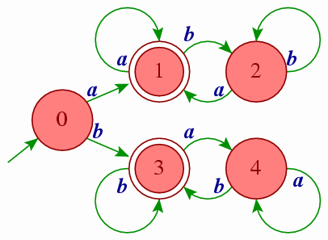

2160704
Theory of Computation
Unit-2
Regular Languages & Finite Automata
Prof. Dixita B. Kagathara
dixita.kagathara@darshan.ac.in

Slide 2
Topics to be covered
Regular expressions & Regular languages
Finite Automata
Union, Intersection and Complement of Regular Languages
Non-Deterministic Finite Automata
Conversion from NFA to FA
^ - Non-Deterministic Finite Automata
Conversion of NFA-^ to FA
Kleene’s Theorem Part – I
Finite Automata with Output (Moore machine, Mealy machine)
Minimization of FA
Moore machine & Mealy machine
Pumping Lemma – Regular and Non Regular Languages

Slide 3
Regular Expression

Slide 4
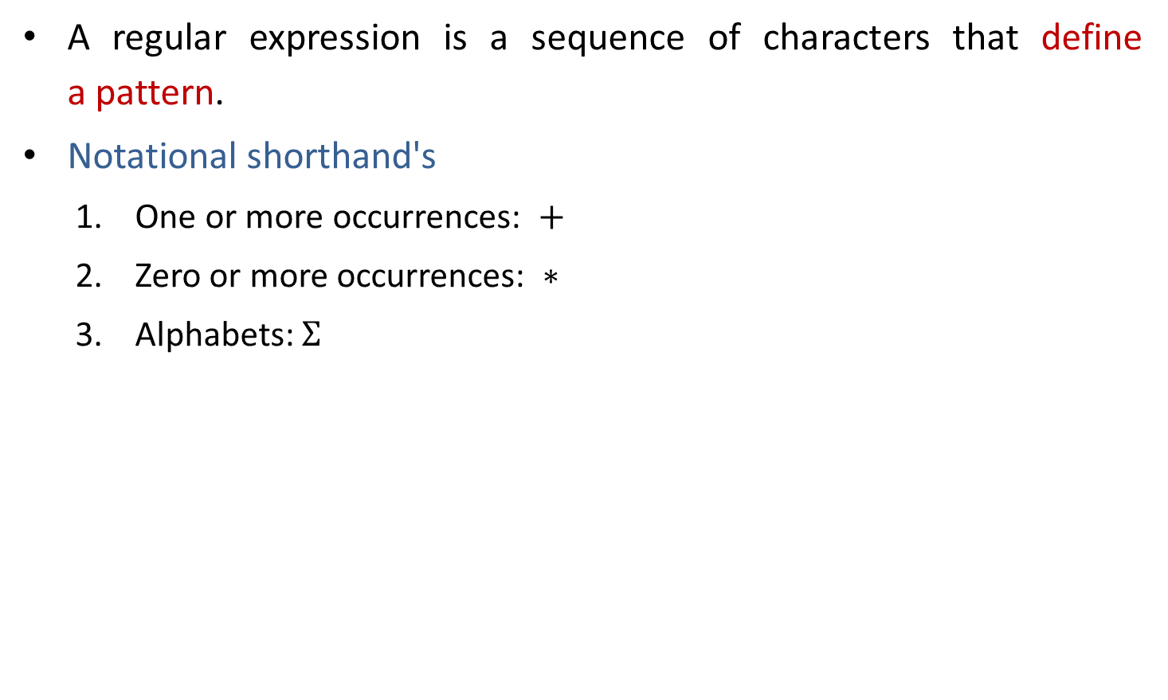
Regular expression
A regular expression is a sequence of characters that define a pattern.
Notational shorthand's
One or more occurrences: $+$
Zero or more occurrences: $∗$
Alphabets: $Σ$

Slide 5
Regular expression
a*
L = Zero or More Occurrences of a =
*
𝜖
a
aa
aaa
Infinite …..
aaaa
aaaaa…..

Slide 6
Regular expression
a⁺
L = One or More Occurrences of a =
+
a
aa
aaa
Infinite …..
aaaa
aaaaa…..

Slide 7
Precedence and associativity of operators
Operator | Precedence | Associative
Kleene * | 1 | left
Concatenation | 2 | left
Union | | 3 | left

Slide 8

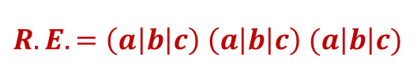



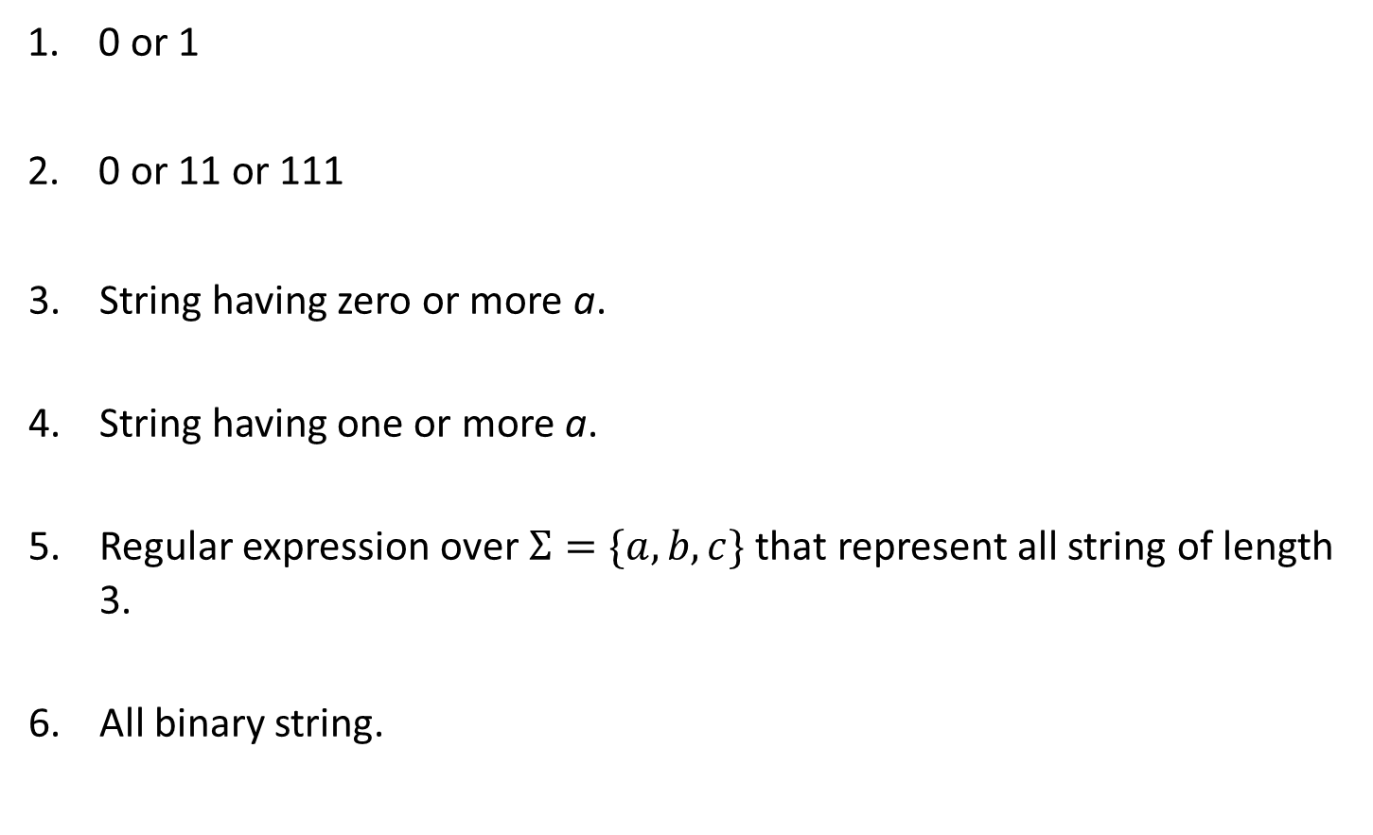







Regular expression examples
0 or 1
0 or 11 or 111
String having zero or more a.
String having one or more a.
Regular expression over $Σ=\{a,b,c\}$ that represent all string of length 3.
All binary string.
$$Strings: 0, 1$$
$$R.E. =0 | 1$$
$$Strings: 0, 11, 111$$
$$R.E. =0 \left| 11 \right| 111$$
$$Strings: ε,a, aa, aaa, aaaa…..$$
$$R.E. =a∗$$
$$Strings:a, aa, aaa, aaaa…..$$
$$R.E. =a+$$
$$Strings:abc, bca, bbb, cab, aba….$$
$$R.E. =\left(a\left|b\right|c\right) \left(a\left|b\right|c\right) (a\left|b\right|c)$$
$$Strings: 0, 11, 101, 10101, 1111…$$
$$R.E. =(0 | 1)+$$

Slide 9

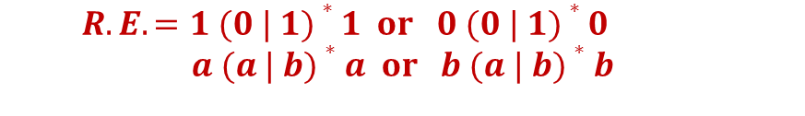







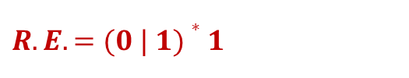


Regular expression examples
0 or more occurrence of either a or b or both
1 or more occurrence of either a or b or both
Binary no. ends with 0
Binary no. ends with 1
Binary no. starts and ends with 1
String starts and ends with same character
$$Strings:ε,a, aa, abab, bab…$$
$$R.E. =(a | b)∗$$
$$Strings:a, aa, abab, bab, bbbaaa…$$
$$R.E. =(a | b)+$$
$$Strings: 0, 10, 100, 1010, 11110…$$
$R.E. =(0 | 1)∗$ $0$
$$Strings:1, 101, 1001, 10101, …$$
$$R.E. =(0 | 1)∗1$$
$$Strings: 11, 101, 1001, 10101, …$$
$R.E. =1 (0 | 1)∗$ $1$
$$Strings:00, 101, aba, baab…$$
$$R.E. =1 (0 | 1)∗1 or 0 (0 | 1)∗0$$
$$a (a | b)∗a or b (a | b)∗b$$

Slide 10





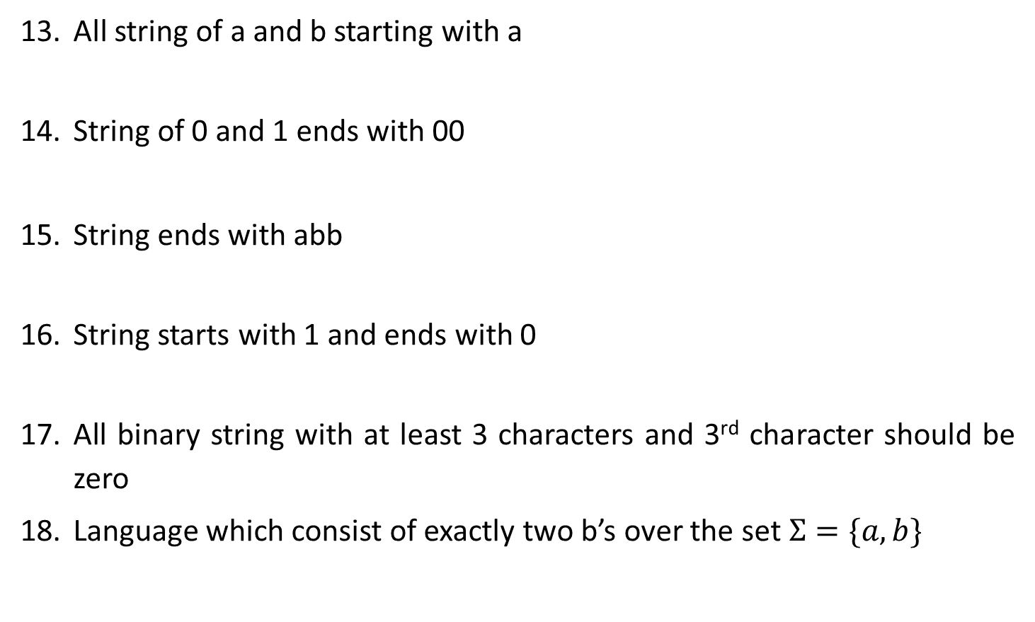







Regular expression examples
All string of a and b starting with a
String of 0 and 1 ends with 00
String ends with abb
String starts with 1 and ends with 0
All binary string with at least 3 characters and 3rd character should be zero
Language which consist of exactly two b’s over the set $Σ=\{a,b\}$
$Strings:a,ab,aab,abb$…
$$R.E. =a(a | b)∗$$
$Strings:00,100,000,1000,1100$…
$$R.E. =(0 | 1)∗00$$
$Strings:abb,babb, ababb$…
$$R.E. =(a | b)∗abb$$
$Strings:10,100,110,1000,1100$…
$$R.E. =1(0 | 1)∗0$$
$Strings:000,100,1100,1001$…
$$R.E. =\left(0 | 1\right)\left(0 | 1\right)0(0 | 1)∗$$
$Strings:bb,bab,aabb,abba$…
$$R.E. =a∗b a∗b a∗$$

Slide 11
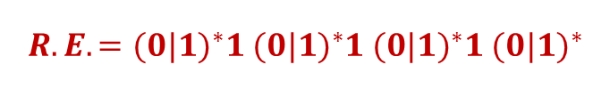



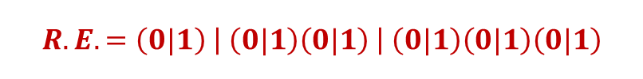
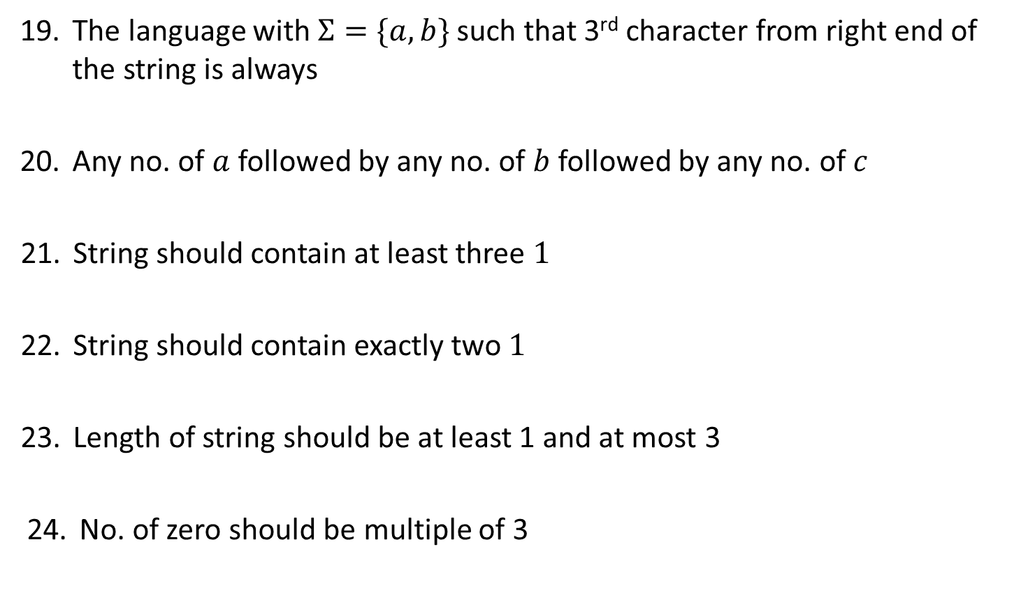




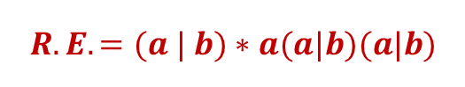


Regular expression examples
The language with $Σ=\{a,b\}$ such that 3rd character from right end of the string is always
Any no. of $a$ followed by any no. of $b$ followed by any no. of $c$
String should contain at least three $1$
String should contain exactly two $1$
Length of string should be at least 1 and at most 3
No. of zero should be multiple of 3
$Strings:aaa,aba,aaba,abb$…
$$R.E. =(a | b)∗a(a|b)(a|b)$$
$Strings:ε,abc,aabbcc,aabc,abb$…
$$R.E. =a∗b∗c∗$$
$Strings:111,01101,0101110$….
$$R.E. ={(0|1)}^{∗}1{ (0|1)}^{∗}1{ (0|1)}^{∗}1 {(0|1)}^{∗}$$
$Strings:11,0101,1100,010010,100100$….
$$R.E. =0^{∗}10^{∗}10^{∗}$$
$Strings:0,1,11,01,111,010,100$….
$$R.E. =\left(0|1\right) \left| \left(0|1\right)\left(0|1\right) \right| \left(0|1\right)\left(0|1\right)\left(0|1\right)$$
$Strings:000,010101,110100,000000,100010010$….
$$R.E. ={(1^{∗}01^{∗}01^{∗}01^{∗})}^{∗}$$

Slide 12





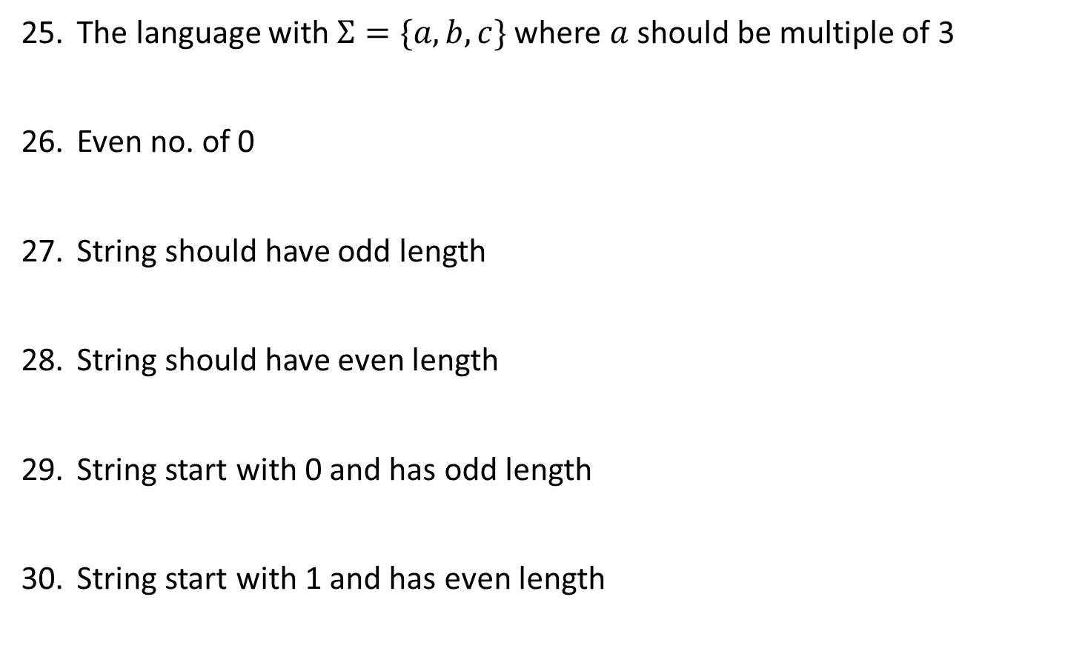




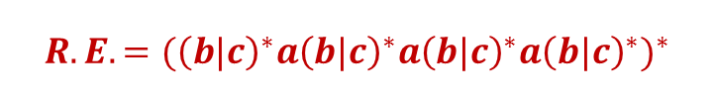


Regular expression examples
The language with $Σ=\{a,b,c\}$ where $a$ should be multiple of 3
Even no. of 0
String should have odd length
String should have even length
String start with 0 and has odd length
String start with 1 and has even length
$$Strings:aaa, baaa,bacaba,aaaaaa..$$
$$R.E. ={({\left(b|c\right)}^{∗}a{\left(b|c\right)}^{∗}a{\left(b|c\right)}^{∗}a{\left(b|c\right)}^{∗})}^{∗}$$
$Strings:00,0101,0000,100100$….
$$R.E. ={(1^{∗}01^{∗}01^{∗})}^{∗}$$
$Strings:0,010,110,000,10010$….
$$R.E. ={\left(0|1\right) (\left(0 | 1\right)(0|1))}^{∗}$$
$Strings:00,0101,0000,100100$….
$$R.E. ={ (\left(0 | 1\right)(0|1))}^{∗}$$
$Strings:0,010,010,000,00010$….
$$R.E. ={\left(0\right) (\left(0 | 1\right)(0|1))}^{∗}$$
$Strings:10,1100,1000,100100$….
$$R.E. ={ 1(0|1)(\left(0 | 1\right)(0|1))}^{∗}$$

Slide 13

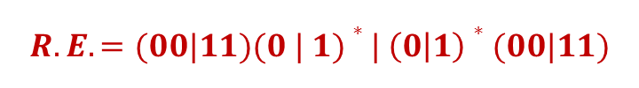






Regular expression examples
All string begins or ends with 00 or 11
Language of all string containing both 11 and 00 as substring
String ending with 1 and not contain 00
Language of C identifier
$$Strings: 00101, 10100,110,01011…$$
$$R.E. =(00|11)(0 | 1)∗| \left(0 | 1\right)∗(00|11)$$
$$Strings: 0011, 1100,100110,010011…$$
$$R.E. ={((0|1)}^{∗}00{(0|1)}^{∗}11{(0|1)}^{∗}) |{ ((0|1)}^{∗}11{(0|1)}^{∗}00{(0|1)}^{∗})$$
$$Strings: 011, 1101,1011….$$
$$R.E. =\left(1 | 01\right)+$$
$$Strings:area, i, redious, grade1….$$
$$R.E. ={(_+L)(_ + L +D)}^{∗}$$
$$where L is Letter \& D is digit$$

Slide 14
Finite Automata

Slide 15
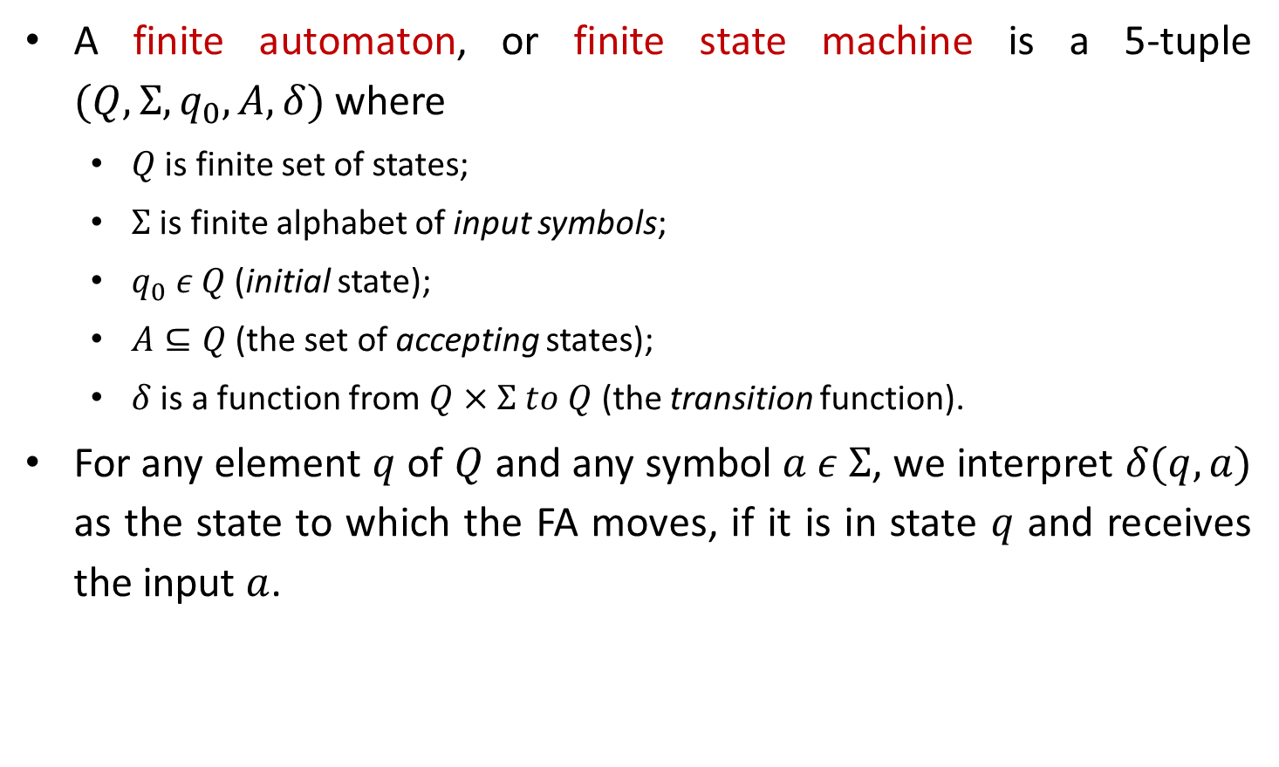
Finite Automata
A finite automaton, or finite state machine is a 5-tuple $(Q,Σ,q_{0},A,δ)$ where
$Q$ is finite set of states;
$Σ$ is finite alphabet of input symbols;
$q_{0} ε Q$ (initial state);
$A⊆Q$ (the set of accepting states);
$δ$ is a function from $Q×Σ to Q$ (the transition function).
For any element $q$ of $Q$ and any symbol $a ε Σ$, we interpret $δ(q,a)$ as the state to which the FA moves, if it is in state $q$ and receives the input $a$.

Slide 16
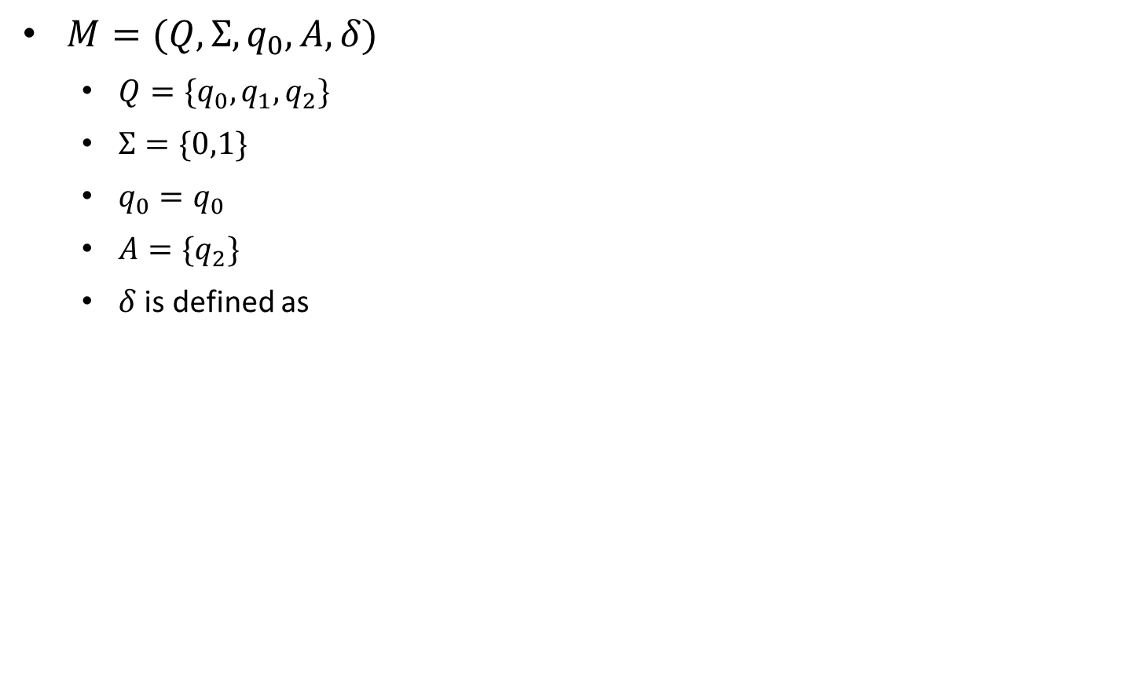

Example: Finite Automata
$M=(Q,Σ,q_{0},A,δ)$
$Q=\{q_{0},q_{1},q_{2}\}$
$Σ=\{0,1\}$
$q_{0}=q_{0}$
$A=\{q_{2}\}$
$δ$ is defined as
δ | Input
State | $$0$$ | $$1$$
$$q_{0}$$ | $$q_{1}$$ | $$q_{0}$$
$$q_{1}$$ | $$q_{2}$$ | $$q_{0}$$
$$q_{2}$$ | $$q_{2}$$ | $$q_{0}$$
1
1
0
$$q_{0}$$
0
$$q_{1}$$
0
$$q_{2}$$
1

Slide 17
Applications of FA
Lexical analysis phase of a compiler.
Design of digital circuit.
String matching.
Communication Protocol for information exchange.

Slide 18


FA Examples
The string with next to last symbol as 0.
0
1
$$C$$
0
$$A$$
0
$$B$$
1
1
$$D$$
0
1

Slide 19

FA Examples
The strings ending with 10.
0
1
0
$$A$$
1
$$B$$
$$C$$
1
0

Slide 20
FA Examples
The string with number of 0’s and number of 1’s are odd
1
odd 0 odd 1
odd 0 even 1
1
0
0
0
0
1
odd 1 even 0
even 1 even 0
1

Slide 21
FA Examples
The string ending in 10 or 11
1
C
0
1
A
1
B
0
0
1
D
0

Slide 22
FA Examples
The string corresponding to Regular expression {00}*{11}*
0,1
B
1
D
0
0
0
0
1
A
1
C
E
1

Slide 23
FA Examples
(a+b)*baaa
b
a
B
a
b
A
b
C
b
b
a
a
E
a
D

Slide 24
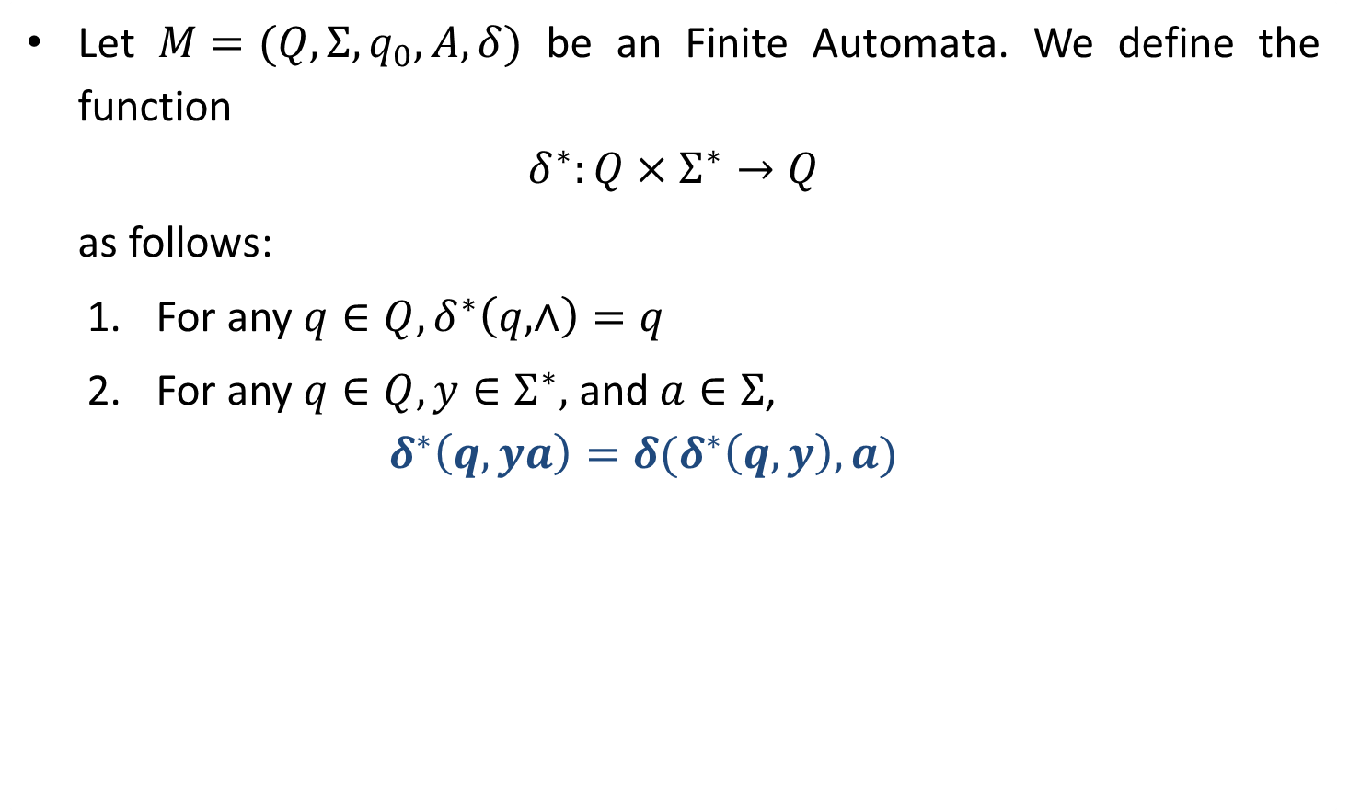
Extended Transition Function $δ^{∗}$ for FA
Let $M=(Q,Σ,q_{0},A,δ)$ be an Finite Automata. We define the function
$$δ^{∗}:Q×Σ^{∗}→Q$$
as follows:
For any $q∈Q,δ^{∗}\left(q,∧\right)=q$
For any $q∈Q, y∈Σ^{∗},$ and $a∈Σ$,
$$δ^{∗}\left(q,ya\right)=δ(δ^{∗}\left(q,y\right),a)$$

Slide 25
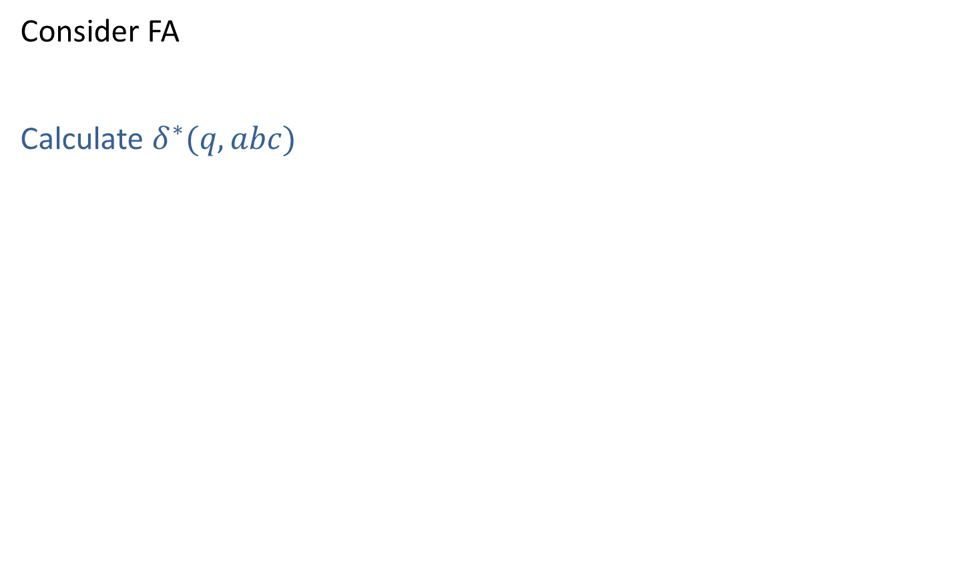
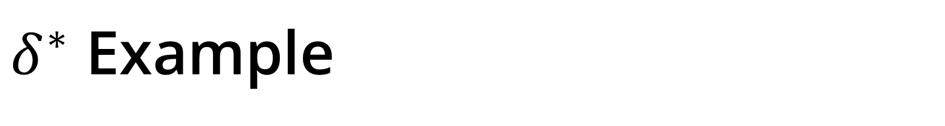
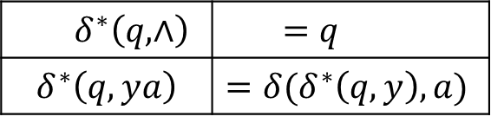
$δ^{∗}$ Example
Consider FA
Calculate $δ^{∗}(q,abc)$
$$q$$
a
$$q_{1}$$
b
$$q_{2}$$
c
$$q_{3}$$
$$δ^{∗}(q,abc)$$ | $$=$$ | $$δ(δ^{∗}\left(q,ab\right),c)$$
 | $$=$$ | $$δ(δ\left(δ^{∗}\left(q,a\right),b\right),c)$$
 | $$=$$ | $$δ(δ\left(δ^{∗}\left(q,⋀a\right),b\right),c)$$
 | $$=$$ | $$δ(δ(δ\left(δ^{∗}\left(q,⋀\right),a),b\right),c)$$
 | $$=$$ | $$δ(δ(δ\left(q,a),b\right),c)$$
 | $$=$$ | $$δ(δ\left(q_{1},b\right),c)$$
 | $$=$$ | $$δ(q_{2},c)$$
 | $$=$$ | $$q_{3}$$
$$δ^{∗}\left(q,∧\right)$$ | $$=q$$
$$δ^{∗}\left(q,ya\right)$$ | $$=δ(δ^{∗}\left(q,y\right),a)$$

Slide 26
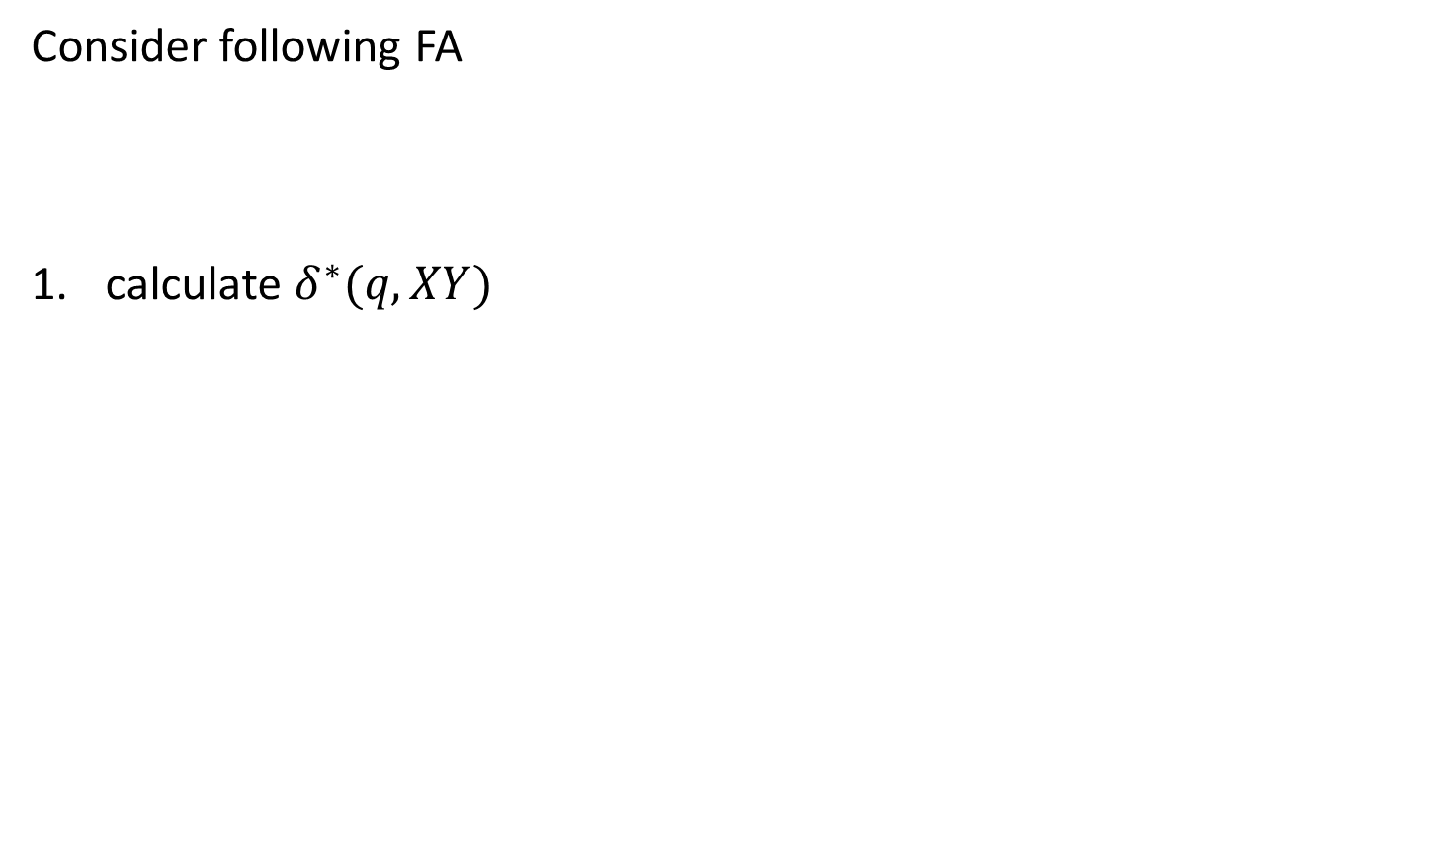
$$Exercise:$$
Consider following FA
calculate $δ^{∗}(q,XY)$
$$q$$
X
$$q_{1}$$
Y
$$q_{2}$$
$$δ^{∗}\left(q,∧\right)$$ | $$=q$$
$$δ^{∗}\left(q,ya\right)$$ | $$=δ(δ^{∗}\left(q,y\right),a)$$

Slide 27
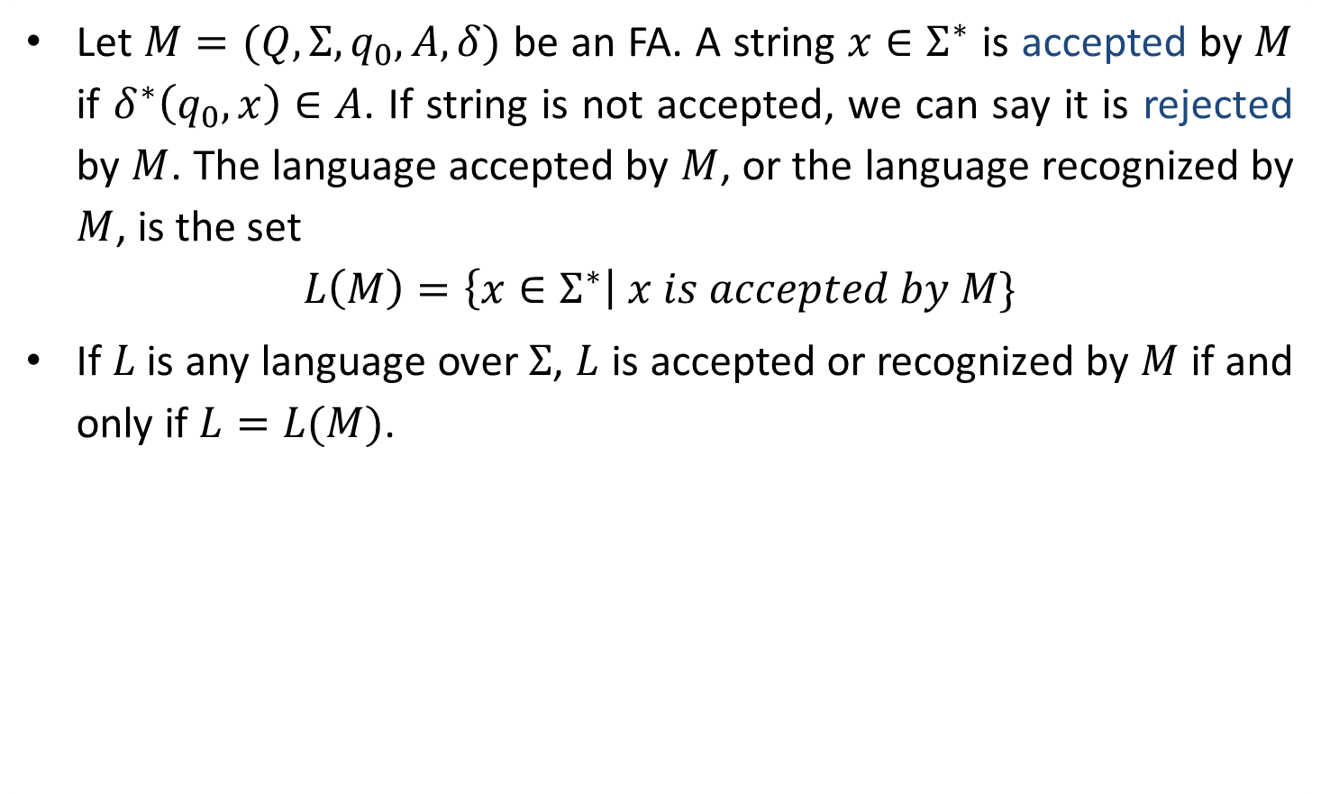
Acceptance by FA
Let $M=(Q,Σ,q_{0},A,δ)$ be an FA. A string $x∈Σ^{∗}$ is accepted by $M$ if $δ^{∗}\left(q_{0},x\right)∈A$. If string is not accepted, we can say it is rejected by $M$. The language accepted by $M$, or the language recognized by $M$, is the set
$$L\left(M\right)=\left\{x∈Σ^{∗}\right| x is accepted by M\}$$
If 𝐿 is any language over $Σ$, $L$ is accepted or recognized by $M$ if and only if $L=L(M)$.

Slide 28
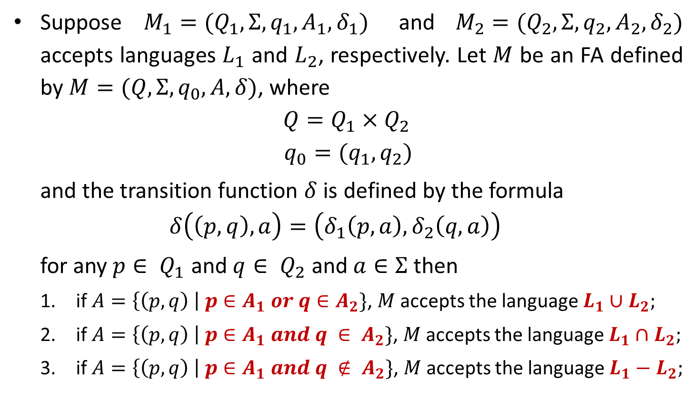
Union, Intersection & Complement of Languages
Suppose $M_{1}=(Q_{1},Σ,q_{1},A_{1},δ_{1})$ and $M_{2}=(Q_{2},Σ,q_{2},A_{2},δ_{2})$ accepts languages $L_{1}$ and $L_{2}$, respectively. Let $M$ be an FA defined by $M=(Q,Σ,q_{0},A,δ)$, where
$$Q=Q_{1}×Q_{2 }$$
$$q_{0}=(q_{1},q_{2})$$
and the transition function $δ$ is defined by the formula
$$δ\left(\left(p,q\right),a\right)=\left(δ_{1}\left(p,a\right),δ_{2}\left(q,a\right)\right)$$
for any $p∈ Q_{1}$ and $q∈ Q_{2}$ and $a∈Σ$ then
if $A=\left\{\left(p,q\right) \right| p∈A_{1} or q∈A_{2}\}$, $M$ accepts the language $L_{1}∪L_{2};$
if $A=\left\{\left(p,q\right) \right| p∈A_{1} and q ∈ A_{2}\}$, $M$ accepts the language $L_{1}∩L_{2};$
if $A=\left\{\left(p,q\right) \right| p∈A_{1} and q ∉ A_{2}\}$, $M$ accepts the language $L_{1}−L_{2};$

Slide 29



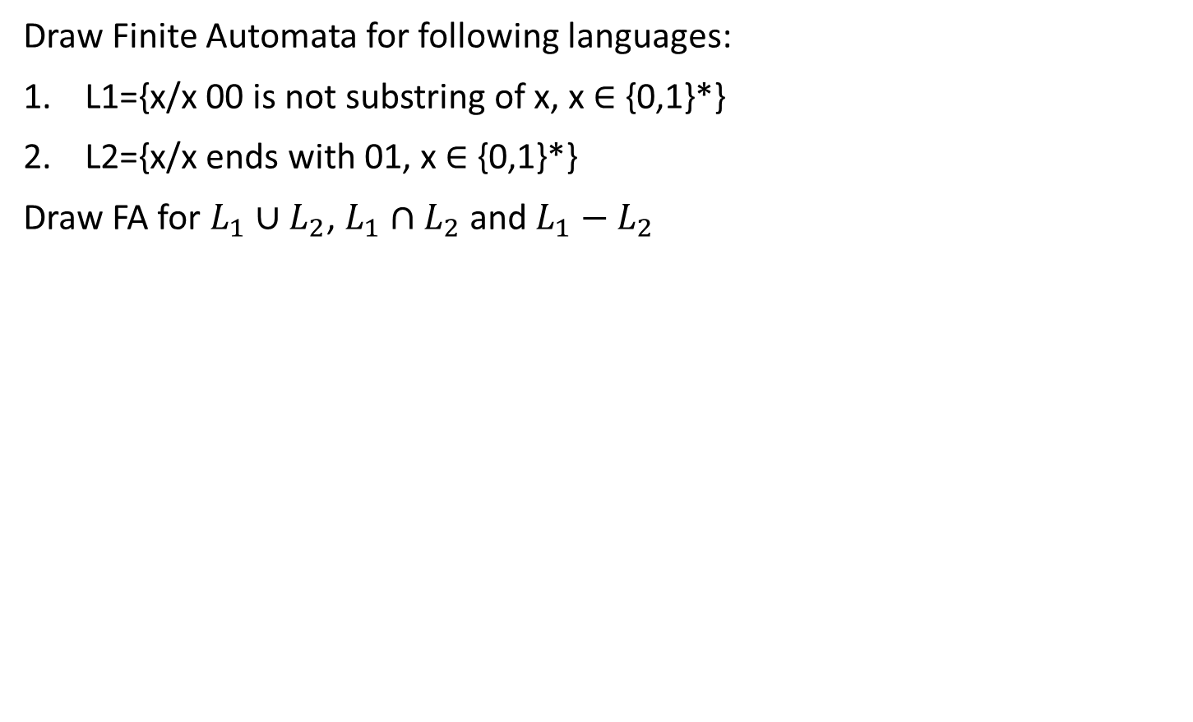


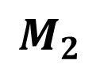

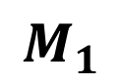
Example
Draw Finite Automata for following languages:
L1={x/x 00 is not substring of x, x ∈ {0,1}*}
L2={x/x ends with 01, x ∈ {0,1}*}
Draw FA for $L_{1}∪L_{2}$, $L_{1}∩L_{2}$ and $L_{1}−L_{2}$
1
0,1
1
0
0
1
$$A$$
$$B$$
0
$$C$$
$$P$$
0
$$Q$$
$$R$$
1
0
1
$$M_{1}$$
$$M_{2}$$

Slide 30
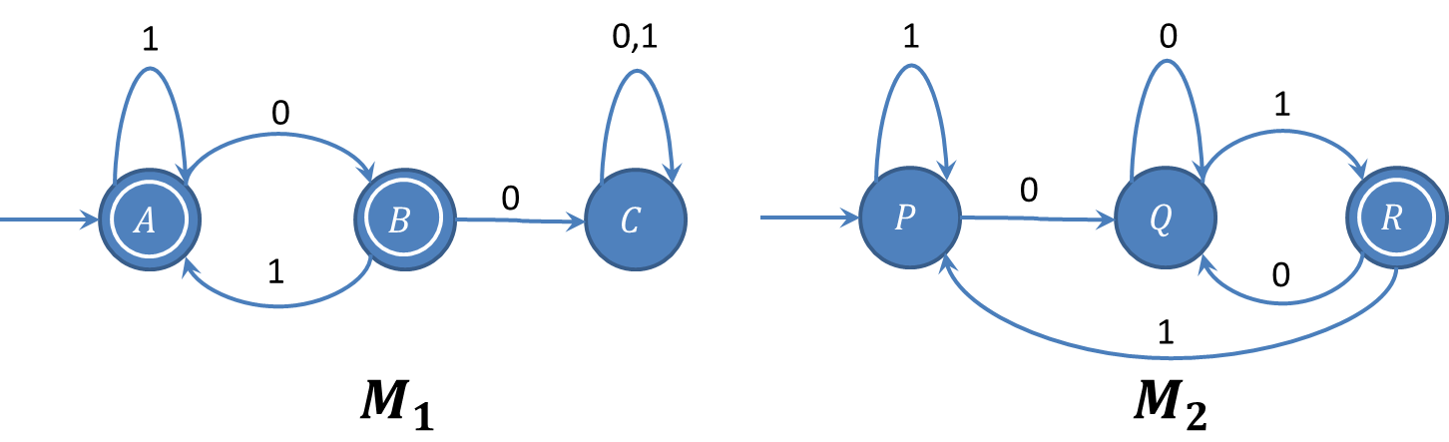


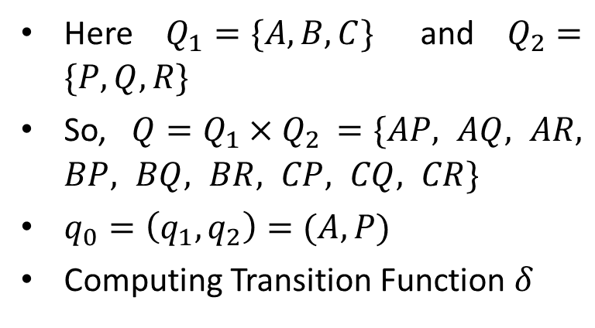
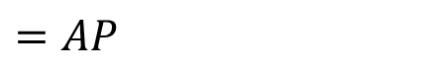


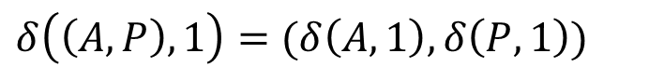

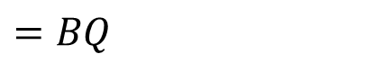


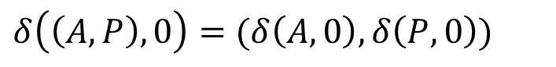


Computation for $L_{1}∪L_{2}$, $L_{1}∩L_{2}$ and $L_{1}−L_{2}$
Here $Q_{1}=\{A,B,C\}$ and $Q_{2}=\{P,Q,R\}$
So, $Q=Q_{1}×Q_{2 }=\{AP, AQ, AR, BP, BQ, BR, CP, CQ, CR\}$
$q_{0}=\left(q_{1},q_{2}\right)=(A,P)$
Computing Transition Function $δ$
1
$$AP$$
$$BP$$
$$CP$$
0
$$AQ$$
$$BQ$$
$$CQ$$
$$δ\left(\left(A,P\right),0\right)=(δ\left(A,0\right),δ\left(P,0\right))$$
$$=BQ$$
$$δ\left(\left(A,P\right),1\right)=(δ\left(A,1\right),δ\left(P,1\right))$$
$$AR$$
$$BR$$
$$CR$$
$$=AP$$
BQ

Slide 31
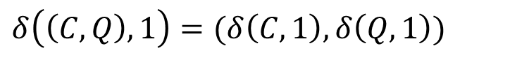
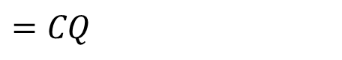
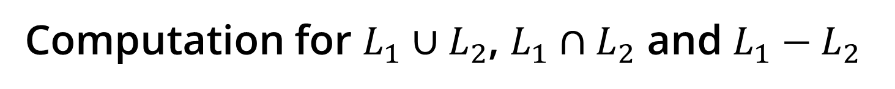
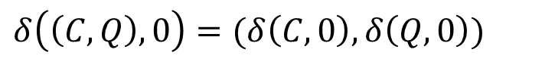
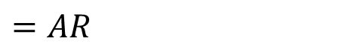
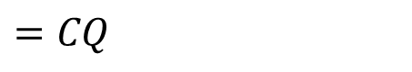
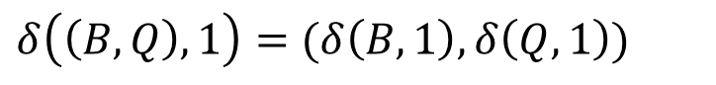
Computation for $L_{1}∪L_{2}$, $L_{1}∩L_{2}$ and $L_{1}−L_{2}$
$$δ\left(\left(B,Q\right),0\right)=(δ\left(B,0\right),δ\left(Q,0\right))$$
1
$$=CQ$$
$$δ\left(\left(B,Q\right),1\right)=(δ\left(B,1\right),δ\left(Q,1\right))$$
$$=AR$$
$$AP$$
$$BP$$
$$CP$$
$$δ\left(\left(C,Q\right),0\right)=(δ\left(C,0\right),δ\left(Q,0\right))$$
0
$$=CQ$$
0
$$δ\left(\left(C,Q\right),1\right)=(δ\left(C,1\right),δ\left(Q,1\right))$$
0
1
$$AQ$$
$$BQ$$
$$CQ$$
$$=CR$$
$$δ\left(\left(A,R\right),0\right)=(δ\left(A,0\right),δ\left(R,0\right))$$
0
1
$$=BQ$$
1
$$δ\left(\left(A,R\right),1\right)=(δ\left(A,1\right),δ\left(R,1\right))$$
$$AR$$
$$BR$$
$$CR$$
$$=AP$$
BQ
CQ
AR
CR

Slide 32
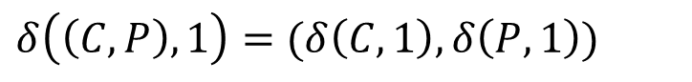
Computation for $L_{1}∪L_{2}$, $L_{1}∩L_{2}$ and $L_{1}−L_{2}$
$$δ\left(\left(C,R\right),0\right)=(δ\left(C,0\right),δ\left(R,0\right))$$
1
1
$$=CQ$$
$$AP$$
$$BP$$
$$CP$$
$$δ\left(\left(C,R\right),1\right)=(δ\left(C,1\right),δ\left(R,1\right))$$
$$=CP$$
0
0
0
$$δ\left(\left(C,P\right),0\right)=(δ\left(C,0\right),δ\left(P,0\right))$$
$$AQ$$
$$BQ$$
0
$$CQ$$
1
1
$$=CQ$$
0
0
1
$$δ\left(\left(C,P\right),1\right)=(δ\left(C,1\right),δ\left(P,1\right))$$
1
$$=CP$$
$$AR$$
$$BR$$
$$CR$$
BQ
CQ
AR
CR
CP

Slide 33








Removing Unconnected States
1
1
$$AP$$
$$BP$$
$$CP$$
0
0
0
$$AQ$$
$$BQ$$
0
$$CQ$$
1
1
0
0
1
1
$$AR$$
$$BR$$
$$CR$$

Slide 34




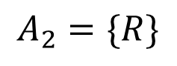

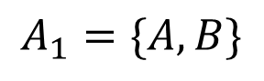


$$L_{1}∪L_{2}$$
$$A_{1}=\{A,B\}$$
1
1
$$A_{2}=\{R\}$$
$$AP$$
$$CP$$
As per theorem stated earlier, the states which consists A or B or R will be Accepting states in the resultant FA.
0
0
0
$$BQ$$
0
$$CQ$$
1
1
0
0
1
1
$$AR$$
$$CR$$
Accepting States $A=\{AP, AR, BQ, CR\}$

Slide 35


$$L_{1}∩L_{2}$$
$$A_{1}=\{A,B\}$$
1
1
$$A_{2}=\{R\}$$
$$AP$$
$$CP$$
Therefore, as per theorem stated earlier, the states which consists (A and R) and (B and R) will be Accepting states in the resultant FA.
0
0
0
$$BQ$$
0
$$CQ$$
1
1
0
0
1
1
$$AR$$
$$CR$$
Accepting States $A=\{AR\}$

Slide 36







$$L_{1}−L_{2}$$
$$A_{1}=\{A,B\}$$
1
1
$$A_{2}=\{R\}$$
$$AP$$
$$CP$$
Therefore, as per theorem stated earlier, the states which consists A or B but should not contain R with them will be Accepting states in the resultant FA.
0
0
0
1
$$BQ$$
0
$$CQ$$
1
0
0
1
1
$$AR$$
$$CR$$
Accepting States $A=\{AP, BQ\}$

Slide 37



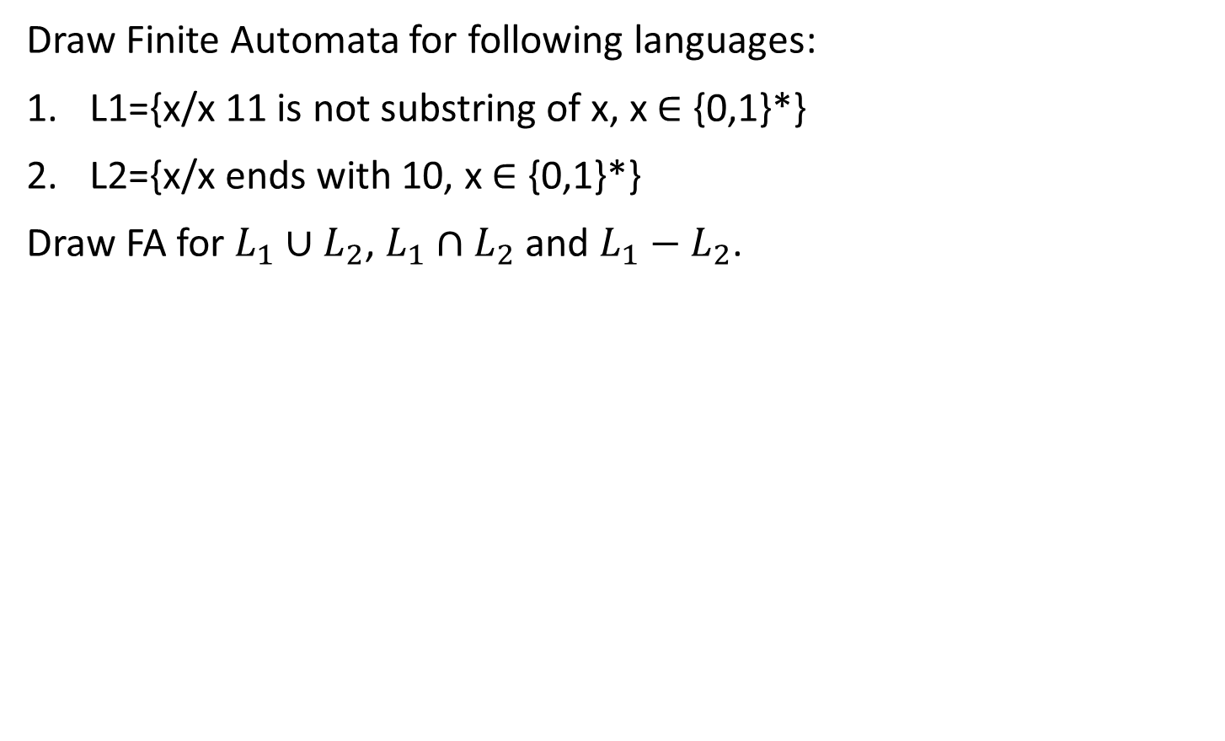


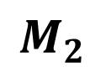

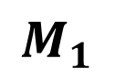
Exercise
Draw Finite Automata for following languages:
L1={x/x 11 is not substring of x, x ∈ {0,1}*}
L2={x/x ends with 10, x ∈ {0,1}*}
Draw FA for $L_{1}∪L_{2}$, $L_{1}∩L_{2}$ and $L_{1}−L_{2}$.
0
0,1
0
1
1
0
$$A$$
$$B$$
1
$$C$$
$$P$$
1
$$Q$$
$$R$$
0
1
0
$$M_{1}$$
$$M_{2}$$

Slide 38
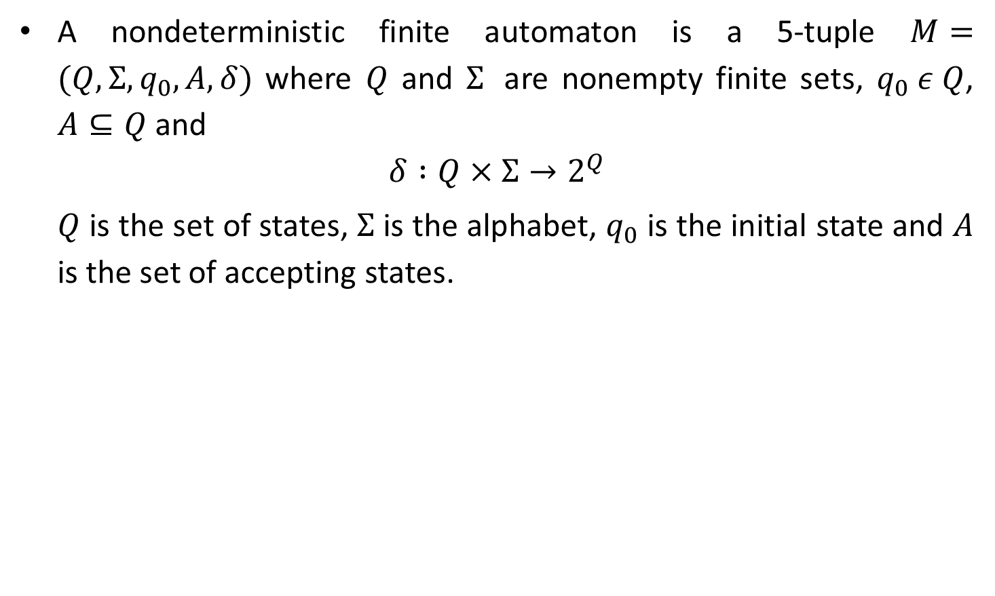
Nondeterministic Finite Automata (NFA)
A nondeterministic finite automaton is a 5-tuple $M=(Q,Σ,q_{0},A,δ)$ where $Q$ and $Σ$ are nonempty finite sets, $q_{0} ε Q$, $A⊆Q$ and
$$δ :Q×Σ→2^{Q}$$
$Q$ is the set of states, $Σ$ is the alphabet, $q_{0}$ is the initial state and $A$ is the set of accepting states.

Slide 39


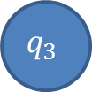
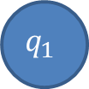
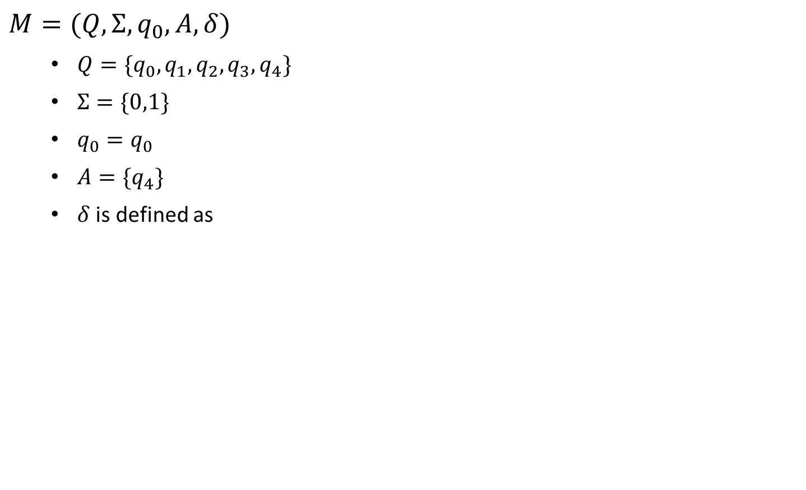


Example of NFA for ${\{11,110\}}^{∗}\{0\}$
$$M=(Q,Σ,q_{0},A,δ)$$
$Q=\{q_{0},q_{1},q_{2},q_{3},q_{4}\}$
$Σ=\{0,1\}$
$q_{0}=q_{0}$
$A=\{q_{4}\}$
$δ$ is defined as
δ | Input
State | $$0$$ | $$1$$
$$q_{0}$$ | $$\{q_{4}\}$$ | $${\{q}_{1},q_{2}\}$$
$$q_{1}$$ | $$∅$$ | $$\{q_{0}\}$$
$$q_{2}$$ | $$∅$$ | $$\{q_{3}\}$$
$$q_{3}$$ | $${\{q}_{0}\}$$ | $$∅$$
$$q_{1}$$
$$q_{4}$$ | $$∅$$ | $$∅$$
1
1
$$q_{0}$$
0
$$q_{4}$$
1
0
$$q_{2}$$
$$q_{3}$$
1

Slide 40
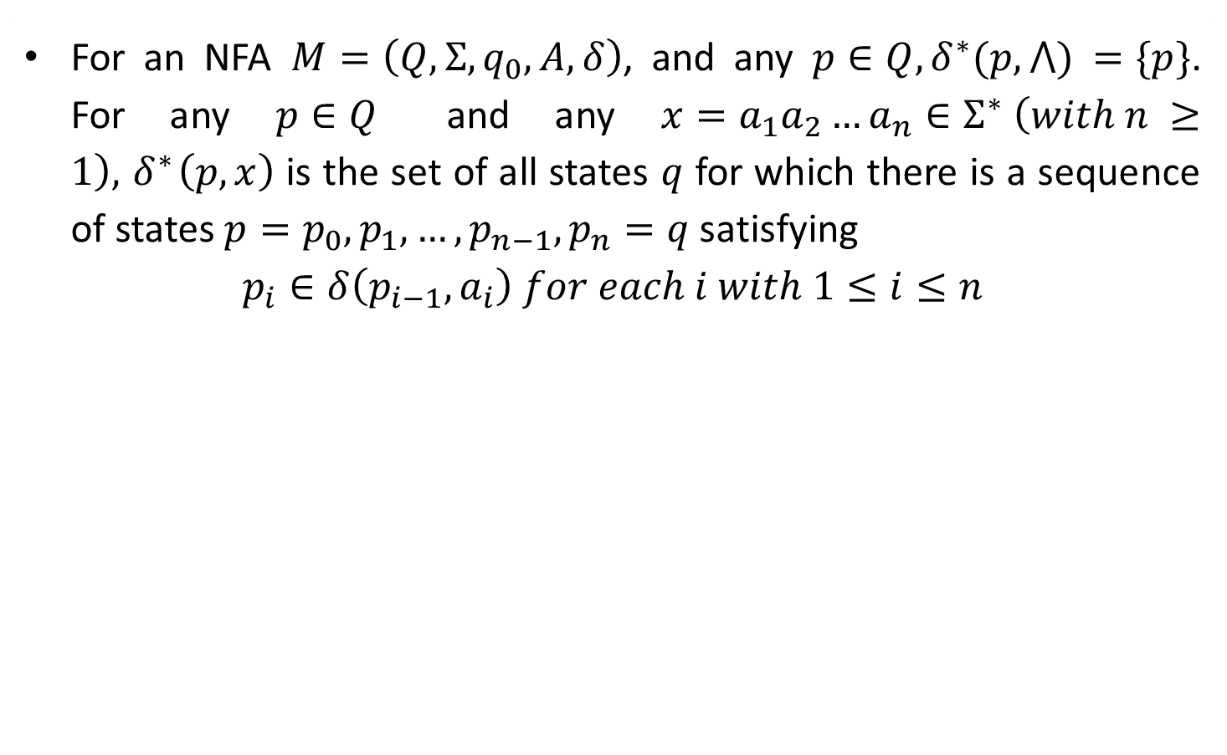

Nonrecursive Definition of $δ^{∗}$ for NFA
For an NFA $M=\left(Q,Σ,q_{0},A,δ\right)$, and any $p∈Q,δ^{∗}(p,⋀)$ $=\{p\}$. For any $p∈Q$ and any $x=a_{1}a_{2}…a_{n}∈Σ^{∗} \left(with n ≥1\right),{ δ}^{∗}\left(p,x\right)$ is the set of all states $q$ for which there is a sequence of states $p=p_{0},p_{1},…,p_{n−1},p_{n}=q$ satisfying
$$p_{i}∈δ\left(p_{i−1},a_{i}\right) for each i with 1≤i≤n$$

Slide 41


Recursive Definition of $δ^{∗}$ for NFA
Let $M=\left(Q,Σ,q_{0},A,δ\right)$ be an NFA. The function $δ^{∗}:Q×Σ^{∗}→2^{Q}$ is defined as follows.
For any $q∈Q$, $δ^{∗}(q,⋀)$ $=\{q\}$.
For any $q∈Q$, $y∈Σ^{∗}$, and $a∈Σ$,
$$δ^{∗}\left(q,ya\right)=\bigcup_{r∈δ^{∗}(q,y)}{δ(r,a)}$$

Slide 42

Acceptance by NFA
Let $M= (Q,Ʃ,q0,A,δ)$be an NFA. The string $x ∈Ʃ∗$ is accepted by $M$ if $δ∗(q0, x) ∩ A≠Ø$. The language recognized, or accepted, by $M$ is the set $L(M)$ of all string accepted by $M$. For any language $L ⊆ Ʃ∗, L$ is recognized by $M if L= L(M).$

Slide 43




Example: Recursive Definition of $δ^{∗}$ in NFA
$M=(Q,Σ,q_{0},A,δ)$
$Q=\{q_{0},q_{1},q_{2},q_{3}\}$
$Σ=\{0,1\}$
$q_{0}=q_{0}$
$A=\{q_{3}\}$
$δ$ is defined as
δ | Input
State | $$0$$ | $$1$$
$$q_{0}$$ | $${\{q}_{o}\}$$ | $${\{q}_{0},q_{1}\}$$
$$q_{1}$$ | $${\{q}_{2}\}$$ | $${\{q}_{2}\}$$
$$q_{2}$$ | $${\{q}_{3}\}$$ | $${\{q}_{3}\}$$
$$q_{3}$$ | $$∅$$ | $$∅$$
0, 1
$$q_{0}$$
1
$$q_{1}$$
0, 1
$$q_{2}$$
0, 1
$$q_{3}$$

Slide 44





Example: Recursive Definition of $δ^{∗}$ in NFA
$$=\bigcup_{r∈δ^{∗}(q_{0},⋀)}{δ(r,0)}$$
$$δ^{∗}\left(q_{0},0\right)$$
$$δ^{∗}\left(q,∧\right)$$ | $$=q$$
$$δ^{∗}\left(q,ya\right)$$ | $$=\bigcup_{r∈δ^{∗}(q,y)}{δ(r,a)}$$
$$=\bigcup_{r∈\{q_{0}\}}{δ(r,0)}$$
$$=δ\left(q_{0},0\right)$$
$$=\left\{q_{0}\right\}$$

Slide 45



Example: Recursive Definition of $δ^{∗}$ in NFA
$$=\bigcup_{r∈δ^{∗}(q_{0},⋀)}{δ(r,1)}$$
$$δ^{∗}\left(q,∧\right)$$ | $$=q$$
$$δ^{∗}\left(q,ya\right)$$ | $$=\bigcup_{r∈δ^{∗}(q,y)}{δ(r,a)}$$
$$δ^{∗}\left(q_{0},1\right)$$
$$=\bigcup_{r∈\{q_{0}\}}{δ(r,1)}$$
$$=δ\left(q_{0},1\right)$$
$$=\left\{q_{0},q_{1}\right\}$$

Slide 46



Example: Recursive Definition of $δ^{∗}$ in NFA
$$=\bigcup_{r∈δ^{∗}(q_{0},1)}{δ(r,1)}$$
$$δ^{∗}\left(q,∧\right)$$ | $$=q$$
$$δ^{∗}\left(q,ya\right)$$ | $$=\bigcup_{r∈δ^{∗}(q,y)}{δ(r,a)}$$
$$δ^{∗}\left(q_{0},11\right)$$
$$=\bigcup_{r∈\{q_{0},q_{1}\}}{δ(r,1)}$$
$$=δ\left(q_{0},1\right)∪ δ\left(q_{1},1\right)$$
$$=\left\{q_{0},q_{1}\right\}∪\{q_{2}\}$$
$$=\left\{q_{0},q_{1},q_{2}\right\}$$

Slide 47


Example: Recursive Definition of $δ^{∗}$ in NFA
$$=\bigcup_{r∈δ^{∗}(q_{0},0)}{δ(r,1)}$$
$$δ^{∗}\left(q_{0},01\right)$$
$$δ^{∗}\left(q,∧\right)$$ | $$=q$$
$$δ^{∗}\left(q,ya\right)$$ | $$=\bigcup_{r∈δ^{∗}(q,y)}{δ(r,a)}$$
$$=\bigcup_{r∈\{q_{0}\}}{δ(r,1)}$$
$$=δ\left(q_{0},1\right)$$
$$=\left\{q_{0},q_{1}\right\}$$

Slide 48





Example: Recursive Definition of $δ^{∗}$ in NFA
$$=\bigcup_{r∈δ^{∗}(q_{0},11)}{δ(r,1)}$$
$$δ^{∗}\left(q_{0},111\right)$$
$$=\bigcup_{r∈\{q_{0},q_{1},q_{2}\}}{δ(r,1)}$$
$$=δ\left(q_{0},1\right)∪ δ\left(q_{1},1\right)∪ δ\left(q_{2},1\right)$$
$$=\left\{q_{0},q_{1},q_{2},q_{3}\right\}$$
$$=\bigcup_{r∈δ^{∗}(q_{0},01)}{δ(r,1)}$$
$$δ^{∗}\left(q_{0},011\right)$$
$$=δ\left(q_{0},1\right)∪ δ\left(q_{1},1\right)$$
$$=\left\{q_{0},q_{1},q_{2}\right\}$$

Slide 49
NFA to FA using subset construction method

Slide 50

Example 1: Conversion from NFA to FA
2
a
b
$$q$$ | $$δ\left(q,a\right)$$ | $$δ\left(q,b\right)$$
1 | {2,3} | {4}
2 | {$φ$} | {4}
3 | {4} | {3}
4 | {$φ$} | $\{φ$}
1
b
4
a
a
3
Transition Table
b
NFA

Slide 51







Example 1: Conversion from NFA to FA
$$δ_{1}\left(1,a\right)= \{2,3\}$$
$$δ_{1}\left(1,b\right)= \{4\}$$
$$δ_{1}\left(\left\{2,3\right\},a\right)= δ\left(2,a\right) ∪δ(3,a)$$
$$= \{4\}$$
$$δ_{1}\left(\left\{2,3\right\},b\right)= δ\left(2,b\right) ∪δ(3,b)$$
$$= \{3,4\}$$
$$δ_{1}(4,a)= \{∅\}$$
1
a
2,3
b
3,4
$$δ_{1}(4,b)= \{∅\}$$
a
b
4

Slide 52





Example 1: Conversion from NFA to FA
$$δ_{1}\left(\{3,4\},a\right)=δ\left(3,a\right) ∪δ(4,a)$$
$$= \{4\}$$
$$δ_{1}\left(\left\{3,4\right\},b\right)= δ\left(3,b\right) ∪δ(4,b)$$
$$= \{3\}$$
$$δ_{1}(3,a)= \{4\}$$
$$δ_{1}(3,b)= \{3\}$$
1
a
2,3
b
3,4
a
a
b
b
4
a
3
b

Slide 53

Example 2: Conversion from NFA to FA
δ | Input
State | $$0$$ | $$1$$
$$q_{0}$$ | $${\{q}_{o}\}$$ | $${\{q}_{0},q_{1}\}$$
$$q_{1}$$ | $${\{q}_{2}\}$$ | $${\{q}_{2}\}$$
$$q_{2}$$ | $${\{q}_{3}\}$$ | $${\{q}_{3}\}$$
$$q_{3}$$ | $$∅$$ | $$∅$$
0, 1
$$q_{0}$$
1
$$q_{1}$$
0, 1
$$q_{2}$$
0, 1
$$q_{3}$$

Slide 54









Example 2: Conversion from NFA to FA
$$q_{0}q_{3}$$
0
0
$$q_{0}q_{2}$$
1
0
$$q_{0}$$
1
$$q_{0}q_{1}$$
$$q_{0}q_{1}q_{3}$$
1
$$q_{0}q_{1}q_{2}$$
$$δ_{1}\left(\{q_{0}\},0\right)=\{q_{0}\}$$
$$δ_{1}\left(\{q_{0}\},1\right)=\{q_{0},q_{1}\}$$
$$δ_{1}\left(\{q_{0},q_{1}\},0\right)=δ\left(\left\{q_{0}\right\},0\right)∪δ\left(\left\{q_{1}\right\},0\right)=\left\{q_{0}\right\}∪\left\{q_{2}\right\}=\{q_{0},q_{2}\}$$
$$δ_{1}\left(\{q_{0},q_{1}\},1\right)=δ\left(\left\{q_{0}\right\},1\right)∪δ\left(\left\{q_{1}\right\},1\right)=\left\{q_{0},q_{1}\right\}∪\left\{q_{2}\right\}=\{q_{0},q_{1},q_{2}\}$$
$$δ_{1}\left(\{q_{0},q_{2}\},0\right)=δ\left(\left\{q_{0}\right\},0\right)∪δ\left(\left\{q_{2}\right\},0\right)=\left\{q_{0}\right\}∪\left\{q_{3}\right\}=\{q_{0},q_{3}\}$$
$$δ_{1}\left(\{q_{0},q_{2}\},1\right)=δ\left(\left\{q_{0}\right\},1\right)∪δ\left(\left\{q_{2}\right\},1\right)=\left\{q_{0},q_{1}\right\}∪\left\{q_{3}\right\}=\{q_{0},q_{1},q_{3}\}$$

Slide 55







Example 2: Conversion from NFA to FA
$$δ_{1}\left(\{q_{0},q_{1},q_{2}\},0\right)=δ\left(\left\{q_{0}\right\},0\right)∪δ\left(\left\{q_{1}\right\},0\right)∪δ\left(\left\{q_{2}\right\},0\right)= \{q_{0},q_{2},q_{3}\}$$
$$δ_{1}\left(\{q_{0},q_{1},q_{2}\},1\right)=δ\left(\left\{q_{0}\right\},1\right)∪δ\left(\left\{q_{1}\right\},1\right)∪δ\left(\left\{q_{2}\right\},1\right)= \{q_{0},q_{1},q_{2},q_{3}\}$$
$$δ_{1}\left(\{q_{0},q_{3}\},0\right)=δ\left(\left\{q_{0}\right\},0\right)∪δ\left(\left\{q_{3}\right\},0\right)= \{q_{0}\}$$
$$δ_{1}\left(\{q_{0},q_{3}\},1\right)=δ\left(\left\{q_{0}\right\},1\right)∪δ\left(\left\{q_{3}\right\},1\right)= \{q_{0},q_{1}\}$$
0
$$q_{0}q_{3}$$
1
0
0
$$q_{0}q_{2}$$
1
$$q_{0}q_{1}q_{3}$$
0
$$q_{0}$$
1
$$q_{0}q_{1}$$
$$q_{0}q_{2}q_{3}$$
0
1
$$q_{0}q_{1}q_{2}$$
1
$$q_{0}q_{1}q_{2}q_{3}$$

Slide 56






Example 2: Conversion from NFA to FA
$$δ_{1}\left(\{q_{0},q_{1},q_{3}\},0\right)=δ\left(\left\{q_{0}\right\},0\right)∪δ\left(\left\{q_{1}\right\},0\right)∪δ\left(\left\{q_{3}\right\},0\right)= \{q_{0},q_{2}\}$$
$$δ_{1}\left(\{q_{0},q_{1},q_{3}\},1\right)=δ\left(\left\{q_{0}\right\},1\right)∪δ\left(\left\{q_{1}\right\},1\right)∪δ\left(\left\{q_{3}\right\},1\right)= \{q_{0},q_{1},q_{2}\}$$
$$δ_{1}\left(\{q_{0},q_{2},q_{3}\},0\right)=δ\left(\left\{q_{0}\right\},0\right)∪δ\left(\left\{q_{2}\right\},0\right)∪δ\left(\left\{q_{3}\right\},0\right)= \{q_{0},q_{3}\}$$
$$δ_{1}\left(\{q_{0},{q_{2},q}_{3}\},1\right)=δ\left(\left\{q_{0}\right\},1\right)∪δ\left(\left\{q_{2}\right\},1\right)∪δ\left(\left\{q_{3}\right\},1\right)= \{q_{0},q_{1},q_{3}\}$$
0
$$q_{0}q_{3}$$
1
0
$$q_{0}q_{2}$$
0
$$q_{0}q_{2}$$
1
$$q_{0}q_{1}q_{3}$$
0
0
0
$$q_{0}$$
1
$$q_{0}q_{1}$$
$$q_{0}$$
$$q_{0}q_{1}$$
1
1
$$q_{0}q_{2}q_{3}$$
0
1
$$q_{0}q_{1}q_{2}$$
$$q_{0}q_{1}q_{2}$$
1
$$q_{0}q_{1}q_{2}q_{3}$$

Slide 57








Example 2: Conversion from NFA to FA
$$δ_{1}\left(\{q_{0},q_{1},q_{2},q_{3}\},0\right)=δ\left(\left\{q_{0}\right\},0\right)∪δ\left(\left\{q_{1}\right\},0\right)∪δ\left(\left\{q_{2}\right\},0\right)∪δ\left(\left\{q_{3}\right\},0\right)= \{q_{0},q_{2},q_{3}\}$$
$$δ_{1}\left(\{q_{0},q_{1},q_{2},q_{3}\},1\right)=δ\left(\left\{q_{0}\right\},1\right)∪δ\left(\left\{q_{1}\right\},1\right)∪δ\left(\left\{q_{2}\right\},1\right)∪δ\left(\left\{q_{3}\right\},1\right)= \{q_{0},q_{1},q_{2},q_{3}\}$$
As now no new states are obtained, the process stops and we need to define the accepting states.
To define accepting states, the states which contain the accepting states of NFA will be accepting states of final FA.
0
$$q_{0}q_{3}$$
1
0
0
$$q_{0}q_{2}$$
1
$$q_{0}q_{1}q_{3}$$
0
0
0
$$q_{0}$$
1
$$q_{0}q_{1}$$
1
1
$$q_{0}q_{2}q_{3}$$
0
1
$$q_{0}q_{1}q_{2}$$
1
0
1
$$q_{0}q_{1}q_{2}q_{3}$$

Slide 58

Nondeterministic Finite Automata with $⋀$-Transitions
A nondeterministic finite automaton with $⋀$-transitions (NFA- $⋀$) is a 5-tuple $M=(Q,Σ,q_{0},A,δ)$ where $Q$ and $Σ$ are finite sets, $q_{0} ε Q$, $A⊆Q$ and
$$δ :Q×(Σ∪\{⋀\})→2^{Q}$$

Slide 59


Nonrecursive Definition of $δ^{∗}$ for NFA- $⋀$
For an NFA - $⋀$ $M=(Q,Σ,q_{0},A,δ)$, states $p,q ∈Q$, and a string $x=a_{1}a_{2}…a_{n}∈Σ^{∗},$ we will say $M$ moves from $p$ to $q$ by a sequence of transition corresponding to $x$ if there exist an integer $m≥n$, a sequence $b_{1},b_{2},…b_{m}∈Σ ⋃\{⋀\}$ satisfying $b_{1}b_{2}…b_{m}=x$, and a sequence of states $p=p_{0},p_{1},…,p_{m}=q$ so that for each $i$ with $1≤i≤m$, $p_{i}∈δ(p_{i−1},b_{i})$.

Slide 60


$⋀$-closure of a Set of States
Let $M=(Q,Σ,q_{0},A,δ)$ be an NFA-$⋀$, and let $S$ be any subset of $Q$. The $⋀$-closure of $S$ is the set $⋀$($S$) defined as follows:
Every element of $S$ is an element of $⋀\left(S\right).$
For any $q∈⋀(S)$, every element of $δ(q,⋀$) is in $⋀\left(S\right).$
No other elements of $Q$ are in $⋀(S)$.

Slide 61















Applying Definitions of $^(S)$
0
1
$$Λ\left(\left\{q_{0}\right\}\right)=$$
$\{$
$$q_{0},$$
$$p,$$
$$t$$
$\}$
$$p$$
1
$$r$$
0
$$s$$
^
^
$${ q}_{0}$$
^
$$w$$
^
$$t$$
0
$$u$$
0
$$v$$
^
1
0

Slide 62








Applying Definitions of $^(S)$
0
1
$$s,$$
$$w,$$
$$q_{0},$$
$$p,$$
$$t$$
$$Λ\left(\left\{s\right\}\right)=$$
$\{$
$\}$
$$p$$
1
$$r$$
0
$$s$$
^
^
$${ q}_{0}$$
^
$$w$$
^
$$t$$
0
$$u$$
0
$$v$$
^
1
0

Slide 63


Recursive Definition of $δ^{∗}$ for NFA- $⋀$
Let $M=\left(Q,Σ,q_{0},A,δ\right)$ be an NFA- $⋀$. The extended transition function $δ^{∗}:Q×Σ^{∗}→2^{Q}$ is defined as follows.
For any $q∈Q, δ^{∗}(q,⋀)$ $=⋀\left(\left\{q\right\}\right).$
For any $q∈Q, y∈Σ^{∗},$and $a∈Σ$,
$$δ^{∗}\left(q,ya\right)=⋀(\bigcup_{r∈δ^{∗}(q,y)}{δ(r,a)})$$
A string $x$ is accepted by $M$ if $δ^{∗}(q_{0},x)⋂A≠φ$. The language recognized by $M$ is the set $L(M)$ of all strings accepted by $M$.

Slide 64




Applying Definition of $δ^{∗}$
0
1
$$δ^{∗}\left(q_{0}, Λ\right)$$
$=Λ(\{q_{0}\})$
$$p$$
1
$$r$$
0
$$s$$
$=\{q_{0},p,t\}$
^
^
$${ q}_{0}$$
^
$$w$$
^
$$t$$
0
$$u$$
0
$$v$$
^
1
0

Slide 65










Applying Definition of $δ^{∗}$
0
1
$$δ^{∗}\left(q_{0}, Λ\right)$$
$=Λ(\{q_{0}\})$
$$p$$
1
$$r$$
0
$$s$$
$=\{q_{0},p,t\}$
$$δ^{∗}\left(q_{0}, 0\right)$$
^
^
$$= Λ\left(\bigcup_{r∈δ^{∗}\left(q_{0}, Λ\right)}{δ\left(r,0\right)}\right)$$
$${ q}_{0}$$
^
$$w$$
$$= Λ\left(\bigcup_{r∈\{q_{0},p,t\}}{δ\left(r,0\right)}\right)$$
^
$$t$$
0
$$u$$
0
$$v$$
^
1
0
$= Λ(δ\left(q_{0},0\right) ∪δ\left(p,0\right) ∪δ\left(t,0\right))$
$= Λ(φ ∪\{p\} ∪\{u\})$
$$δ^{∗}\left(q,∧\right)$$ | $$=^\{q\}$$
$$δ^{∗}\left(q,ya\right)$$ | $$=^(\bigcup_{r∈δ^{∗}\left(q,y\right)}{δ\left(r,a\right)})$$
$= Λ(\{p,u\})$
$= \{p,u\}$

Slide 66











Applying Definition of $δ^{∗}$
$$δ^{∗}\left(q_{0}, 01\right)= Λ\left(\bigcup_{r∈δ^{∗}\left(q_{0}, 0\right)}{δ\left(r,1\right)}\right)$$
$= Λ(δ\left(p,1\right) ∪δ\left(u,1\right))$
$= Λ(\{r\})$
$= \{r\}$
$$δ^{∗}\left(q_{0}, 010\right) = Λ\left(\bigcup_{r∈δ^{∗}\left(q_{0}, 01\right)}{δ\left(r,0\right)} \right)$$
$= Λ(δ\left(r,0\right))$
$= Λ(\{s\})$
$$δ^{∗}\left(q,∧\right)$$ | $$=^\{q\}$$
$$δ^{∗}\left(q,ya\right)$$ | $$=^(\bigcup_{r∈δ^{∗}\left(q,y\right)}{δ\left(r,a\right)})$$
$= \{s,w,q_{0},p,t\}$

Slide 67
NFA-^ to FA

Slide 68


NFA - $⋀$ to FA
NFA - $⋀$
NFA
FA

Slide 69


Conversion from NFA- $^$ to FA
$$q$$ | $$δ\left(q,^\right)$$ | $$δ\left(q,0\right)$$ | $$δ\left(q,1\right)$$
A | {B} | {A} | $$φ$$
B | {D} | {C} | $$φ$$
C | $$φ$$ | $$φ$$ | {B}
D | $$φ$$ | {D} | $$φ$$
C
0
0
0
1
A
^
B
^
D

Slide 70










Conversion from NFA- ^ to FA
C
Step 1: To convert NFA - ^ to NFA
$$δ^{∗}\left(A,^\right)$$
$$=Λ\left\{A\right\}=\{A,B,D\}$$
0
0
$$=Λ\left(\bigcup_{r∈δ^{∗}\left(A, ^\right)}{δ\left(r,0\right)} \right)$$
$$δ^{∗}\left(A,0\right)$$
A
0
B
D
$$=Λ\left(\bigcup_{r∈\{A,B,D\}}{δ\left(r,0\right)} \right)$$
0
$$q$$ | $$δ^{∗}\left(q,0\right)$$ | $$δ^{∗}\left(q,1\right)$$
$$A$$ | $$\{A,B,C,D\}$$ | $$φ$$
$$B$$ | $$\{C,D\}$$ | $$φ$$
$$C$$ | $$φ$$ | $$\{B,D\}$$
$$D$$ | $$\{D\}$$ | $$φ$$
$$=Λ(δ\left(A,0\right)∪δ\left(B,0\right)∪δ\left(D,0\right))$$
$$=Λ(\left\{A,C,D\right\})$$
$$=\{A,B,C,D\}$$

Slide 71




Conversion from NFA- $^$ to FA
$$=Λ\left(\bigcup_{r∈δ^{∗}\left(A, ^\right)}{δ\left(r,1\right)} \right)$$
C
$$δ^{∗}\left(A,1\right)$$
$$=Λ\left(\bigcup_{r∈\{A,B,D\}}{δ\left(r,1\right)} \right)$$
0
0
A
0
B
D
$$=Λ\left(δ\left(A,1\right)\right)∪δ\left(B,1\right)∪δ\left(D,1\right)$$
$$=Λ(φ)$$
0
$$=φ$$
$$q$$ | $$δ^{∗}\left(q,0\right)$$ | $$δ^{∗}\left(q,1\right)$$
$$A$$ | $$\{A,B,C,D\}$$ | $$φ$$
$$B$$ | $$\{C,D\}$$ | $$φ$$
$$C$$ | $$φ$$ | $$\{B,D\}$$
$$D$$ | $$\{D\}$$ | $$φ$$

Slide 72









Conversion from NFA- ^ to FA
$$δ^{∗}\left(B,^\right)$$
$$=Λ\left\{B\right\}=\{B,D\}$$
C
$$=Λ\left(\bigcup_{r∈δ^{∗}\left(B, ^\right)}{δ\left(r,0\right)} \right)$$
$$δ^{∗}\left(B,0\right)$$
0
0
0
$$=Λ\left(\bigcup_{r∈\{B,D\}}{δ\left(r,0\right)} \right)$$
A
0
B
0
D
$$=Λ(δ\left(B,0\right)∪δ\left(D,0\right))$$
0
$$=Λ(\left\{C,D\right\})$$
$$q$$ | $$δ^{∗}\left(q,0\right)$$ | $$δ^{∗}\left(q,1\right)$$
$$A$$ | $$\{A,B,C,D\}$$ | $$φ$$
$$B$$ | $$\{C,D\}$$ | $$φ$$
$$C$$ | $$φ$$ | $$\{B,D\}$$
$$D$$ | $$\{D\}$$ | $$φ$$
$$=\{C,D\}$$

Slide 73




Conversion from NFA- ^ to FA
$$=Λ\left(\bigcup_{r∈δ^{∗}\left(B, ^\right)}{δ\left(r,1\right)} \right)$$
C
$$δ^{∗}\left(B,1\right)$$
$$=Λ\left(\bigcup_{r∈\{B,D\}}{δ\left(r,1\right)} \right)$$
0
0
0
A
0
B
0
D
$$=Λ(δ\left(B,1\right)∪δ\left(D,1\right))$$
$$=Λ(φ)$$
0
$$=φ$$
$$q$$ | $$δ^{∗}\left(q,0\right)$$ | $$δ^{∗}\left(q,1\right)$$
$$A$$ | $$\{A,B,C,D\}$$ | $$φ$$
$$B$$ | $$\{C,D\}$$ | $$φ$$
$$C$$ | $$φ$$ | $$\{B,D\}$$
$$D$$ | $$\{D\}$$ | $$φ$$

Slide 74








Conversion from NFA- ^ to FA
$$δ^{∗}\left(C,^\right)$$
$$=Λ\left\{C\right\}=\{C\}$$
C
$$=Λ\left(\bigcup_{r∈δ^{∗}\left(C, ^\right)}{δ\left(r,0\right)} \right)$$
$$δ^{∗}\left(C,0\right)$$
0
0
0
$$=Λ\left(\bigcup_{r∈\{C\}}{δ\left(r,0\right)} \right)$$
A
0
B
0
D
$$=Λ(δ\left(C,0\right))$$
0
$$=Λ(φ)$$
$$q$$ | $$δ^{∗}\left(q,0\right)$$ | $$δ^{∗}\left(q,1\right)$$
$$A$$ | $$\{A,B,C,D\}$$ | $$φ$$
$$B$$ | $$\{C,D\}$$ | $$φ$$
$$C$$ | $$φ$$ | $$\{B,D\}$$
$$D$$ | $$\{D\}$$ | $$φ$$
$$=φ$$

Slide 75






Conversion from NFA- $^$ to FA
$$=Λ\left(\bigcup_{r∈δ^{∗}\left(C, ^\right)}{δ\left(r,1\right)} \right)$$
C
$$δ^{∗}\left(C,1\right)$$
$$=Λ\left(\bigcup_{r∈\{C\}}{δ\left(r,1\right)} \right)$$
0
0
0
1
1
A
0
B
0
D
$$=Λ(δ\left(C,1\right))$$
$$=Λ(\{B\})$$
0
$$=\{B,D\}$$
$$q$$ | $$δ^{∗}\left(q,0\right)$$ | $$δ^{∗}\left(q,1\right)$$
$$A$$ | $$\{A,B,C,D\}$$ | $$φ$$
$$B$$ | $$\{C,D\}$$ | $$φ$$
$$C$$ | $$φ$$ | $$\{B,D\}$$
$$D$$ | $$\{D\}$$ | $$φ$$

Slide 76








Conversion from NFA- ^ to FA
$$δ^{∗}\left(D,^\right)$$
$$=Λ\left\{D\right\}=\{D\}$$
C
$$=Λ\left(\bigcup_{r∈δ^{∗}\left(D, ^\right)}{δ\left(r,0\right)} \right)$$
$$δ^{∗}\left(D,0\right)$$
0
0
0
1
1
0
$$=Λ\left(\bigcup_{r∈\{D\}}{δ\left(r,0\right)} \right)$$
A
0
B
0
D
$$=Λ(δ\left(D,0\right))$$
0
$$=Λ(\{D\})$$
$$q$$ | $$δ^{∗}\left(q,0\right)$$ | $$δ^{∗}\left(q,1\right)$$
$$A$$ | $$\{A,B,C,D\}$$ | $$φ$$
$$B$$ | $$\{C,D\}$$ | $$φ$$
$$C$$ | $$φ$$ | $$\{B,D\}$$
$$D$$ | $$\{D\}$$ | $$φ$$
$$=\{D\}$$

Slide 77








Conversion from NFA- ^ to FA
$$=Λ\left(\bigcup_{r∈δ^{∗}\left(D, ^\right)}{δ\left(r,1\right)} \right)$$
C
$$δ^{∗}\left(D,1\right)$$
0
0
0
$$=Λ\left(\bigcup_{r∈\{D\}}{δ\left(r,1\right)} \right)$$
0
1
1
A
0
B
0
D
$$=Λ(δ\left(D,1\right))$$
$$=Λ(φ)$$
0
$$q$$ | $$δ^{∗}\left(q,0\right)$$ | $$δ^{∗}\left(q,1\right)$$
$$A$$ | $$\{A,B,C,D\}$$ | $$φ$$
$$B$$ | $$\{C,D\}$$ | $$φ$$
$$C$$ | $$φ$$ | $$\{B,D\}$$
$$D$$ | $$\{D\}$$ | $$φ$$
$$=φ$$
{
Accepting State
=
$A∪\left\{q_{0}\right\}$if $Λ\left(\left\{q_{0}\right\}\right)∩A≠φ$ in $M$
$A$ otherwise
Resulting NFA

Slide 78








Conversion from NFA- ^ to FA
$$q$$ | $$δ^{∗}\left(q,0\right)$$ | $$δ^{∗}\left(q,1\right)$$
$$A$$ | $$\{A,B,C,D\}$$ | $$φ$$
$$B$$ | $$\{C,D\}$$ | $$φ$$
$$C$$ | $$φ$$ | $$\{B,D\}$$
$$D$$ | $$\{D\}$$ | $$φ$$
Step 2: To convert NFA to FA
$$δ\left(\{A\},0\right)= \{A,B,C,D\}$$
$$δ\left(\{A\},1\right)= φ$$
$$δ\left(\{A,B,C,D\},0\right)=(δ\left(A,0\right) ∪δ\left(B,0\right) ∪δ\left(C,0\right) ∪δ\left(D,0)\right)$$
$= \{A,B,C,D\}$ $∪$ {C,D} $∪$ {$φ$}$∪$ {D} = $\{A,B,C,D\}$
$$δ\left(\{A,B,C,D\},1\right)=(δ\left(A,1\right) ∪δ\left(B,1\right) ∪δ\left(C,1\right) ∪δ\left(D,1)\right)$$
$$= \{B,D\}$$
0
$$δ\left(\{B,D\},0\right)=(δ\left(B,0\right) ∪δ\left(D,0)\right)$$
ABCD
1
BD
0
$$= \{C,D\}$$
$$δ\left(\{B,D\},1\right)=(δ\left(B,1\right) ∪δ\left(D,1)\right)$$
0
CD
$$=φ$$
A

Slide 79






Conversion from NFA- ^ to FA
$$q$$ | $$δ^{∗}\left(q,0\right)$$ | $$δ^{∗}\left(q,1\right)$$
$$A$$ | $$\{A,B,C,D\}$$ | $$φ$$
$$B$$ | $$\{C,D\}$$ | $$φ$$
$$C$$ | $$φ$$ | $$\{B,D\}$$
$$D$$ | $$\{D\}$$ | $$φ$$
$$δ\left(\{C,D\},0\right)=(δ\left(C,0\right) ∪δ\left(D,0)\right)$$
$$= \{D\}$$
$$δ\left(\{C,D\},1\right)=(δ\left(C,1\right) ∪δ\left(D,1)\right)$$
0
$$= \{B,D\}$$
ABCD
1
BD
$$δ\left(\{D\},0\right)= \{D\}$$
0
$$δ\left(\{D\},1\right)= φ$$
0
1
A
CD
FA
0
D
0

Slide 80
Kleene’s Theorem Part-1

Slide 81

Kleene’s Theorem Part-1
Statement: Any regular language can be accepted by a finite automaton.
Proof:
On the basis of statement, $L$can be recognized by FA, NFA and NFA-^. It is sufficient to so that every regular language can be accepted by NFA- ^.
Set of regular language over alphabet $Σ$ contains the basic languages Ø, {^} and $\left\{a\right\}(a∈Σ)$ to be closed under operation of union, concatenation, and Kleene*.
This allows us to prove using structural induction that every regular language over $Σ$ can be accepted by an NFA-^.
The basis step of the proof is to show that the three basic languages can be accepted by NFA- ^s.
The induction hypothesis is that $L_{1}$ and $L_{2}$ are languages that can be accepted by NFA- ^s and the induction step is to show that $L_{1}∪L_{2},L_{1}L_{2}$ and $L_{1}^{∗}$ can also be.

Slide 82

Kleene’s Theorem Part-1
NFA-^ for the three basic languages is shown below.
Now, suppose that $L_{1}$ and $L_{2}$ are recognized by the NFA-^s $M_{1}$ and $M_{2}$, respectively, where for both $i$=1 and $i$=2,
$$M_{i}=(Q_{i},Σ,q_{i},A_{i},δ_{i})$$
By renaming states if necessary, we may assume that $Q_{1}$ ∩ $Q_{2}$ = Ø. We will construct NFA-^s $M_{u}$, $M_{c}$, and $M_{k}$ recognizing the language $L_{1}$ U $L_{2}$, $L_{1}L_{2}$, and $L_{1}^{∗}$, respectively.
a
Ø
{^}
{a}

Slide 83








Kleene’s Theorem Part-1
Construction of $M_{u}=\left(Q_{u},Σ,q_{u},A_{u},δ_{u}\right)$
Let $q_{u}$ be a new state, not in either $Q_{1}$ or $Q_{2}$ and let
$Q_{u}$ = $Q_{1}$ U $Q_{2}$ U {$q_{u}$}
$A_{u}$ = $A_{1}$ U $A_{2}$
$${ f}_{1}$$
$${ q}_{1}$$
^
$$f_{1}^{′}$$
$${ q}_{u}$$
$${ f}_{2}$$
^
$${ q}_{2}$$
$$f_{2}^{′}$$

Slide 84

Kleene’s Theorem Part-1
Now, we define $δ_{u}$ so that $M_{u}$ can move from its initial state to either $q_{1}$ or $q_{2}$ by a ^ transition, and then make exactly the same moves that the respective $M_{i}$ would.
Formally we define:
$δ_{u}\text{(}q_{u}\text{,^) = \{}q_{1}\text{, }q_{2}\text{\}}$
$δ_{u}(q_{u},a)$ = Ø for every $a∈Σ$
and for each $q$ ∈ $Q_{1}$ U $Q_{2}$ and $a$ ∈ $Σ$ U {^},
$δ_{u}\left(q_{u},a\right)=$ $δ_{1}(q,a)$ if $q∈Q_{1}$
$δ_{u}\left(q_{u},a\right)=δ_{2}(q,a)$ if $q∈Q_{2}$

Slide 85

Kleene’s Theorem Part-1
For either value of $i$, if $x∈L_{i}$, then $M_{u}$ can process 𝑥 by moving to $q_{i}$ on a ^-transition and then executing the moves that cause $M_{i}$ to accept 𝑥.
On the other hand, if 𝑥 is accepted by $M_{u}$, there is a sequence of transition corresponding to 𝑥, starting at $q_{u}$ and ending at an element of $A_{1}$ or $A_{2}$.
The first of these transitions must be a ^-transition from $q_{u}$ to either $q_{1}$or $q_{2}$, since there are no other transition from $q_{u}$.
Thereafter, since $Q_{1}$ ∩ $Q_{2}$ = Ø, either all the transition are between of $Q_{1}$ or all are between elements of $Q_{2}$. It follow that 𝑥 must be accepted by either $M_{1}$ or $M_{2}$.

Slide 86







Kleene’s Theorem Part-1
Construction of $M_{c}$= ($Q_{c}$, $Σ$, $q_{c}$, $A_{c}$, $δ_{c}$)
Let $Q_{c}$ = $Q_{1}$ U $Q_{2}$, $q_{c}$=$q_{1}$, and $A_{c}$ = $A_{2}$. The transition will include all those of $M_{1}$ and $M_{2}$ as well as a $⋀$ - transition from each state in $A_{1}$ to $q_{2}$.
In other words, for any $q$ not in $A_{1}$, and $α∈Σ∪\{⋀\}$, $δ_{c}(q,α)$ is defined to be either $δ_{1}$(q,a) or $δ_{2}$(q,a), depending on whether $q$ is in $Q_{1}$ and $Q_{2}$.
$${ f}_{1}$$
$${ f}_{2}$$
^
$${ q}_{c} {=q}_{1}$$
$${ q}_{2}$$
$$f_{1}^{′}$$
^
$$f_{2}^{′}$$

Slide 87

Kleene’s Theorem Part-1
For $q∈A_{1}$,
$δ_{c}\left(q,a\right)=δ_{1}(q,a)$ for every $a∈Σ$, and $δ_{c}\left(q,⋀\right)=δ_{1}(q,⋀)$ U {$q_{2}$}
On an input string $x_{1}x_{2}$, where $x_{i}$ ∈ $L_{i}$ for both value of $i$, $M_{c}$ can process $x_{1}$, arriving at a state $A_{1}$; jump from this state to $q_{2}$ by a $⋀$- transition; and then process $x_{2}$the way $M_{2}$would, so that $x_{1}x_{2}$ is accepted.
Conversely, if $x$ is accepted by $M_{c}$, there is a sequence of transition corresponding to $x$ that begins at $q_{1}$ and ends at an element of $A_{2}$.
One of them must therefore be from an element of $Q_{1}$ to an element of $Q_{2}$, and according to the definition of$δ_{c}$, this can only be a $⋀$- transition from an element of $A_{1}$ to $q_{2}$. Because $Q_{1}$ ∩ $Q_{2}$= Ø, all the previous transition are between elements of $Q_{1}$ and all the subsequent ones are between elements of $Q_{2}$.
It follows that ${x=x}_{1}∧x_{2}=x_{1}x_{2}$, where $x_{1}$ is accepted by $M_{1}$ and $x_{2}$ is accepted by $M_{2}$; in other words, ${x∈L}_{1}L_{2}$.

Slide 88




Kleene’s Theorem Part-1
Construction of $M_{k}$= ($Q_{k}$, $Σ$, $q_{k}$, $A_{k}$, $δ_{k}$)
Let $q_{k}$ be a new state not in $Q_{1}$ and let $Q_{k}$= $Q_{1}$ U {$q_{k}$} and $A_{k}=\{q_{k}\}$.
Once again all the transitions of $M_{1}$ will be allowed in $M_{k}$, but in addition there is a $⋀$- transition from $q_{k}$ to $q_{1}$ and there is a $⋀$-transition from each elements of $A_{1}$ to $q_{k}$.
$${ q}_{1}$$
^
$${ q}_{k}$$
^
$${ f}_{1}$$
$$f_{1}^{′}$$
^

Slide 89

Kleene’s Theorem Part-1
More precisely,
$δ_{k}(q_{k},⋀)$ = $\{q_{1}\}$ and $δ_{k}\left(q_{k},a\right)=$ Ø for $a∈Σ$
For $q∈Q_{1}$ and $α∈Σ∪\{⋀\}$, $δ_{k}\left(q,α\right)=δ_{1}\left(q,α\right)$ unless $q∈A_{1}$ and $α$ = $⋀$.
For $q∈A_{1}$, $δ_{k}\left(q,⋀\right)=δ_{1}\left(q,⋀\right)$ $∪{\{q}_{k}\}$.
Suppose $x∈L_{1}^{∗}$. If $x=⋀$ then clearly $x$ is accepted by $M_{k}$. Otherwise, for some $m≥1, x=x_{1}x_{2}…x_{m},$ where$x_{i}∈L_{1}$ for each $i$, $M_{k}$ can move from $q_{k}$ to $q_{1}$ by a $⋀$- transition; for each $i$, $M_{k}$ moves from $q_{1}$ to an element $f_{i}$ of $A_{1}$ by a sequence of transition corresponding to $x_{i}$; and for each $i$, $M_{k}$ then moves from $f_{i}$ back to $q_{k}$ by a $⋀$- transition.

Slide 90

Kleene’s Theorem Part-1
It follows that $(⋀ x_{1}⋀)(⋀ x_{2}⋀)$…$(⋀ x_{m}⋀)$= $x$ is accepted by $M_{k}$.
On the other hand, if $x$ is accepted by $M_{k}$, there is a sequence of transition corresponding to $x$ that begins and ends at $q_{k}$. Since the only transition from $q_{k}$ is a $⋀$ - transition to $q_{1}$, and the only transition to $q_{k}$ are $⋀$- transition from elements of $A_{1}$, $x$ can be decomposed in the form
$x=(⋀ x_{1}⋀)(⋀ x_{2}⋀)$…$(⋀ x_{m}⋀)$
where, for each $i$, there is a sequence of transitions corresponding to $x_{i}$ from $q_{1}$ to an element of $A_{1}$. Therefore, $x∈L_{1}^{∗}$.
Since we have constructed an NFA - $⋀$ recognizing $L$ in each of the three cases, the proof is complete.

Slide 91
Application of Kleene’s Theorem

Slide 92
Regular expression to NFA-^
Convert ${\left(aa+b\right)}^{∗}$ to NFA-^
a
^
a
b

Slide 93
Regular expression to NFA-^
Convert ${\left(aa+b\right)}^{∗}$ to NFA-^
^
a
^
a
^
^
b
^
^

Slide 94
Regular expression to NFA-^
Convert ${\left(00+1\right)}^{∗}{(10)}^{∗}$ to NFA-^
0
^
0
1

Slide 95
Regular expression to NFA-^
Convert ${\left(00+1\right)}^{∗}{(10)}^{∗}$ to NFA-^
0
^
0
^
1
^
^
0
^
0
^
^
1
^
^

Slide 96
Regular expression to NFA-^
Convert ${\left(00+1\right)}^{∗}{(10)}^{∗}$ to NFA-^
^
^
1
^
0

Slide 97
Regular expression to NFA-^
Convert ${\left(00+1\right)}^{∗}{(10)}^{∗}$ to NFA-^
^
0
^
0
^
^
1
^
^
^
^
^
1
^
0

Slide 98
Exercise (RE to NFA-^)
00
00+1
(00+1)*
(0+1)*
(111)*
(10+01)*
(0+1)*(11+00)*11
(10+110)*(0+1)*1
(00+1)*(10)*
(a+b)(a+b)*
(aab)*b*(a+b)*

Slide 99
Finite Automata with Output

Slide 100
Finite automata with output
Finite automata has limited capability of either accepting a string or rejecting a string. Acceptance of string was based on the reachability of a machine from starting state to final state.
Finite automata with output do not have a final state.
Machine generates output on every input.
There are two types of automata with outputs:
Moore machine
Mealy machine

Slide 101




Moore machine & Mealy Machine
FA with Output
Moore Machine
Mealy Machine
$$M_{0}=(Q,Σ,Δ,δ,λ^{′},q_{0})$$
$$Output is associated with state$$
$$Output is associated with transition$$
$Q$ : set of states
$Σ$ : input symbols
$Δ$ : output symbols
$δ$ : Transition function
$λ^{′}$: output function
$q_{0}$ : initial state
a
b
a|1
b|0
X,1
b
Y,0
X
b|0
Y
a
a|1

Slide 102

Moore Machine
Mathematically Moore machine is a six tuple machine and defined as
$$M_{0}=(Q,Σ,Δ,δ,λ^{′},q_{0})$$
where,
$Q$ : a nonempty finite set of states in $M_{0}$
$Σ$ : a nonempty finite set of input symbols
$Δ$ : a nonempty finite set of outputs
$δ$ : Transition function which takes two arguments as in finite automata, one is input state and other is input symbol. The output of this function is a single state.
$λ^{′}$: it is a mapping function which maps $Q$ to $Δ$, giving the output associated with each state.
$q_{0}$ : the initial state of $M_{0}$ and $q_{0}$∈ $Q$

Slide 103
Example: Moore Machine
Design a moore machine for the 1’s compliment of binary number.
1
0
A,0
0
B,1
1

Slide 104



Example: Moore Machine
Design a moore machine to count occurrence of “ab” as substring.
b
a
b
$$A,0$$
a
$$B,0$$
$$C,1$$
a
b

Slide 105




Example: Moore Machine
Construct a moore machine that takes set of all strings over {0, 1} and produces ‘A’ if i/p ends witg ‘10’ , produces ‘B’ if i/p ends with ’11’ otherwise produces ‘C’.
10→A
11→B
Otherwise →C
0
1
$$x,C$$
1
$$y,C$$
1
$$z,B$$
0
1
0
0
$$w,A$$

Slide 106
Example: Moore Machine
Construct a moore machine that takes binary number as an i/p and produces residue modulo ‘3’ as an output.
Input={0,1}
∆={0, 1, 2}
 | 0 | 1 | ∆
A | A | B | 0
B | C | A | 1
C | B | C | 2
Transition Table
0
1
A,0
1
B,1
0
C,2
1
0

Slide 107

Mealy Machine
Mathematically Mealy machine is a six tuple machine and defined as
$$M_{e}=(Q,Σ,Δ,δ,λ^{′},q_{0})$$
where,
$Q$ : a nonempty finite set of states in $M_{e}$
$Σ$ : a nonempty finite set of input symbols
$Δ$ : a nonempty finite set of outputs
$δ$ : Transition function which takes two arguments as in finite automata, one is input state and other is input symbol. The output of this function is a single state.
$λ^{′}$: It is a mapping function which maps $Q×Σ$ to $Δ$, giving the output associated with each transition.
$q_{0}$ : the initial state of $M_{e}$ and $q_{0}$∈ $Q$

Slide 108
Example: Mealy Machine
Design a mealy machine for the 1’s compliment of binary number
0/1
1/0
A

Slide 109
Example: Mealy Machine
Design a mealy machine for regular expression (0+1)*(00+11).
0|y
00→y
11→y
Otherwise →x
q2
0|x
q1
0|x
1|x
1|x
q3
1|y

Slide 110
Moore to Mealy Machine Conversion

Slide 111
Conversion of Moore into Mealy Machine
$${ q}_{1}$$
1
Moore machine
a
a
0
1
a,b
Start
$${ q}_{0}$$
$${ q}_{3}$$
b
b
$${ q}_{2}$$
b
$${ q}_{1}$$
a/1
a/1
0
a
a/1,b/1
Start
$${ q}_{0}$$
$${ q}_{3}$$
b/0
b/0
$${ q}_{2}$$
b/1
Mealy machine
a/0

Slide 112
Mealy to Moore Machine Conversion

Slide 113





Conversion of Mealy to Moore machine
0|0
0|1
$$A$$
1|1
$$B$$
Mealy machine
1|0
0
0
1
$$A,0$$
1
$$B,1$$
1
$$B,0$$
Moore machine
0

Slide 114


Exercise: Mealy machine to Moore machine
0|y
GTU- May 2016, 7 Marks
q2
b|0
a|1
0|x
a|0
$$s0$$
$$s1$$
q1
0|x
1|x
b|1
1|x
q3
1|y

Slide 115
Minimization of FA

Slide 116






Example: Minimize FA
Final state is {6}
And, Non-Final state is {1,2,3,4,5,7}
(6, 1), (6,2), (6, 3), (6, 4), (6, 5), (6, 7) are distinguish pairs.
Consider pair (1,2)
δ(1,a)=2 δ(1,b)=3
δ(2,a)=4 δ(2,b)=5
Consider pair (1,3)
δ(1,a)=2 δ(1,b)=3
δ(3,a)=6 δ(3,b)=7
pair (2,6) is distinguish, so (1,3) is distinguished pair.
Consider pair (1,4)
δ(1,a)=2 δ(1,b)=3
δ(4,a)=4 δ(4,b)=5
a
$$4$$
a
$$2$$
b
a
a
b
$$5$$
$$1$$
b
a
b
$$6$$
a
$$3$$
a
b
b
2
3 | X | X
4 |  |  | X
5 | X | X |  | X
6 | X | X | X | X | X
7 | X | X |  | X |  | X
 | 1 | 2 | 3 | 4 | 5 | 6
7
b

Slide 117
Example: Minimize FA
a
Consider pair (1,5)
δ(1,a)=2 δ(1,b)=3
δ(5,a)=6 δ(5,b)=7
pair (2,6) is distinguish, so (1,5) is distinguished pair.
Consider pair (1,7)
δ(1,a)=2 δ(1,b)=3
δ(7,a)=6 δ(7,b)=7
pair (2,6) is distinguish, so (1, 7) is distinguished pair.
Consider pair (2,3)
δ(2,a)=4 δ(2,b)=5
δ(3,a)=6 δ(3,b)=7
pair (4,6) is distinguish, so (2, 3) distinguished pair.
Consider pair (2,4)
δ(2,a)=4 δ(2,b)=5
δ(4,a)=4 δ(4,b)=5
$$4$$
a
$$2$$
b
a
a
b
$$5$$
$$1$$
b
a
b
$$6$$
a
$$3$$
a
b
b
2
3 | X | X
4 |  |  | X
5 | X | X |  | X
6 | X | X | X | X | X
7 | X | X |  | X |  | X
 | 1 | 2 | 3 | 4 | 5 | 6
7
b

Slide 118
Example: Minimize FA
a
Consider pair (2,5)
δ(2,a)=4 δ(2,b)=5
δ(5,a)=6 δ(5,b)=7
pair (4,6) is distinguish, so (2,5) is distinguished pair.
Consider pair (2,7)
δ(2,a)=4 δ(2,b)=5
δ(7,a)=6 δ(7,b)=7
pair (4,6) is distinguish, so (2,7) is distinguished pair.
Consider pair (3,4)
δ(3,a)=6 δ(3,b)=7
δ(4,a)=4 δ(4,b)=5
pair (6,4) is distinguish, so (3,4) is distinguish pair.
Consider pair (3,5)
δ(3,a)=6 δ(3,b)=7
δ(5,a)=6 δ(5,b)=7
$$4$$
a
$$2$$
b
a
a
b
$$5$$
$$1$$
b
a
b
$$6$$
a
$$3$$
a
b
b
2
3 | X | X
4 |  |  | X
5 | X | X |  | X
6 | X | X | X | X | X
7 | X | X |  | X |  | X
 | 1 | 2 | 3 | 4 | 5 | 6
7
b

Slide 119
Example: Minimize FA
a
Consider pair (3,7)
δ(3,a)=6 δ(3,b)=7
δ(7,a)=6 δ(7,b)=7
Consider pair (4,5)
δ(4,a)=4 δ(4,b)=5
δ(5,a)=6 δ(5,b)=7
pair (6,4) is distinguish, so (4,5) is distinguish.
Consider pair (4,7)
δ(4,a)=4 δ(4,b)=5
δ(7,a)=6 δ(7,b)=7
pair (4,6) is distinguish, so (4,7) is distinguish.
Consider pair (5,7)
δ(5,a)=6 δ(5,b)=7
δ(7,a)=6 δ(7,b)=7
$$4$$
a
$$2$$
b
a
a
b
$$5$$
$$1$$
b
a
b
$$6$$
a
$$3$$
a
b
b
2
3 | X | X
4 |  |  | X
5 | X | X |  | X
6 | X | X | X | X | X
7 | X | X |  | X |  | X
 | 1 | 2 | 3 | 4 | 5 | 6
7
b

Slide 120







Example: Minimize FA
a
$$4$$
a
b
a
a
$$2$$
b
a
a
b
$$5$$
$$124$$
b
$$357$$
$$6$$
$$1$$
b
a
b
$$6$$
a
b
a
$$3$$
a
b
$${Minimized FA}_{}$$
b
2
3 | X | X
4 |  |  | X
5 | X | X |  | X
6 | X | X | X | X | X
7 | X | X |  | X |  | X
 | 1 | 2 | 3 | 4 | 5 | 6
7
b
1=2
1=4
2=4
1=2=4
3=5
3=7
5=7
3=5=7

Slide 121
Pumping lemma

Slide 122

Define pumping lemma and its application.
Suppose L is a regular language. Then there is an integer n so that for any x∈ L with |x|>=n, there are strings u, v, and w so that
x=uvw
|uv|<=n
|v|>0
For any m>=0, $uv^{m}w$ ∈ L
Application
The pumping lemma is extremely useful in proving that certain sets are non-regular. The general methodology followed during its applications is
Select a string z in the language L.
Break the string z into x, y and z in accordance with the above conditions imposed by the pumping lemma.
Now check if there is any contradiction to the pumping lemma for any value of i.

Slide 123

Use the pumping lemma to show that following language is not regular: L = {ww|w ϵ {0,1}*}
Step 1:
Let us assume that L is regular and L is accepted by an FA with n states.
Step 2:
Let us chose the string
$$ῳ= \frac{a^{n}b}{ῳ}\frac{a^{n}b}{ῳ}$$
$$ῳ =2n+2≥n$$
Let us write w as xyz with
|y| > 0
And |xy|<=n
Since |xy|<=n, x must be of the form $a^{s}$.
Since |xy|<=n, y must be of the form $a^{r}$ | r>0
Now $ῳ=$ $a^{n}ba^{n}b$ = $\frac{a^{s}}{x} \frac{a^{r}}{y}\frac{a^{n−s−r}ba^{n}b}{z}$

Slide 124

Use the pumping lemma to show that following language is not regular: L = {ww|w ϵ {0,1}*}
Step 3:
Let us check whether x $y^{i}$z for i=2 belongs to L.
${xy}^{2}z$ = $a^{s}a^{2r}a^{n−s−r}ba^{n}b$ = $a^{n+r}ba^{n}b$
Since, r>0, $a^{n+r}ba^{n}b$is not of the form $ῳ$ $ῳ$ as the number of a’s in the first half is n+r and second half is n.
Therefore, ${xy}^{2}z$ Ɇ L. Hence by contradiction we can say language is not regular.

Slide 125
End of Unit - 2

